Slide 1
水閥瑕疵檢測 Water Valve Defect Inspection
凌宇帆 Yu-Fan Ling
Professor: 傅楸善 Chiou-Shann Fuh
Email: r11945060@ntu.edu.tw
Phone: 0933066688
Collaboration: 晟格科技 Chernger

Slide 2
Outline
Introduction
Environment
Demonstration
Process
Problems and Solutions
Conclusion
Reference

Slide 3
Introduction
Water valve cores have been used in our lives for a long time, and Maruwa (丸和) company manufactures many water valve cores everyday.
However, during the production process, there are some defect on valve cores.
Our goal is to inspect all defects with optical defect inspection.

Slide 4
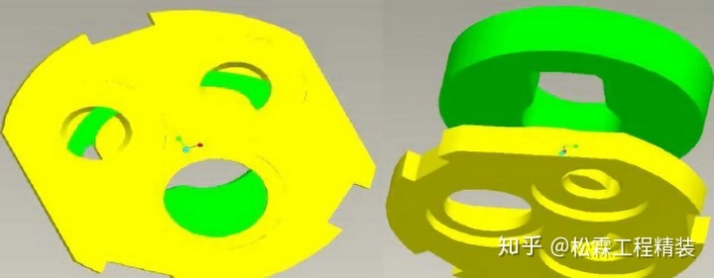
Introduction
Water valve core usually has three parts.
Select cold or hot water or stop water by turning the faucet.
There are chipping and crack and no lap defects on valve cores, these defects will interfere with the original capabilities.
Hence, we need to find out all the defects to guarantee the yield rate.

Slide 5
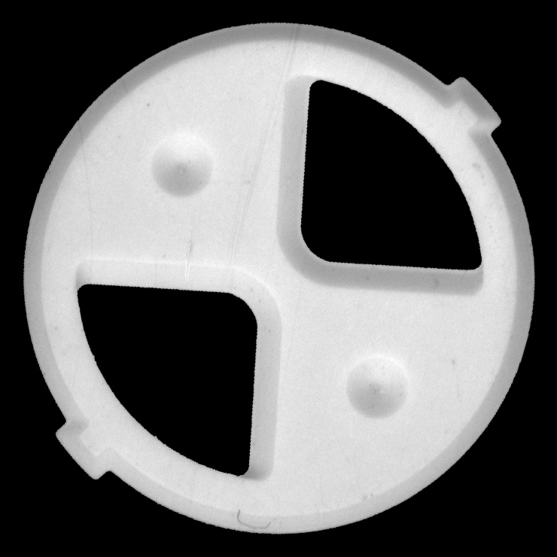
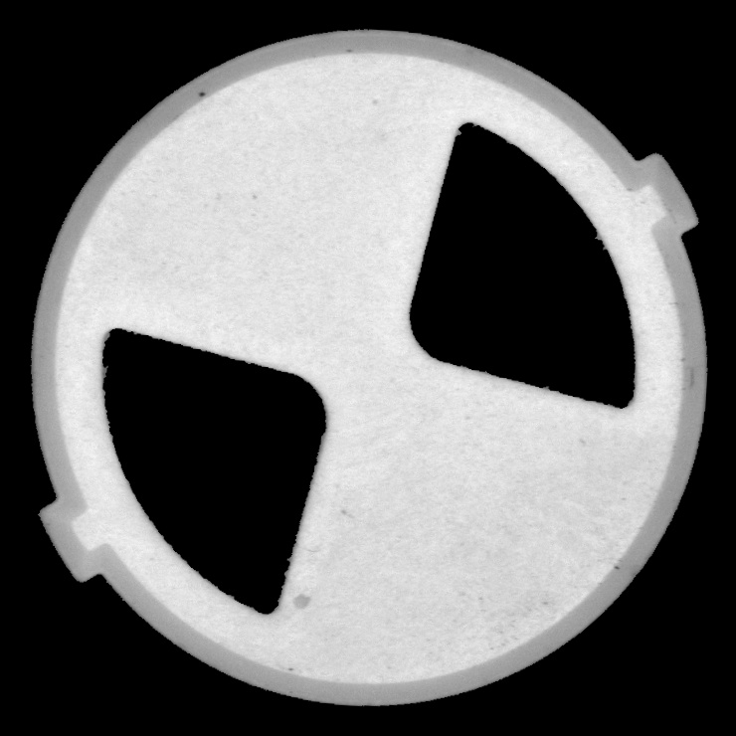
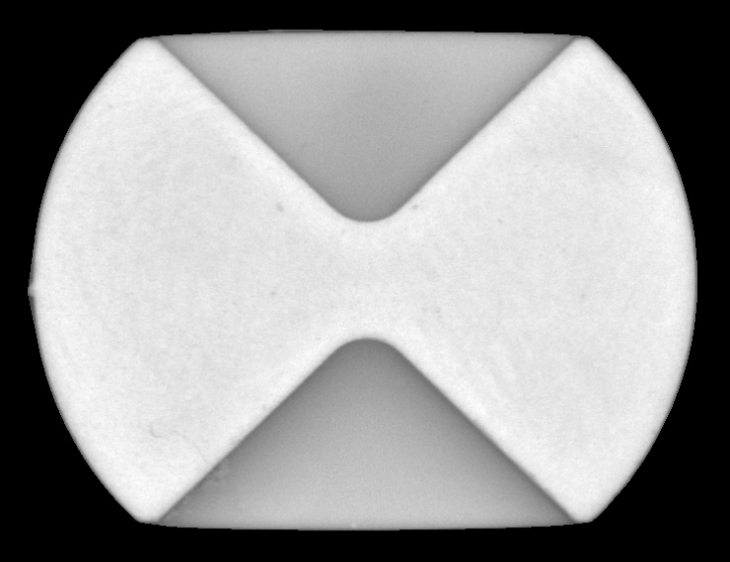
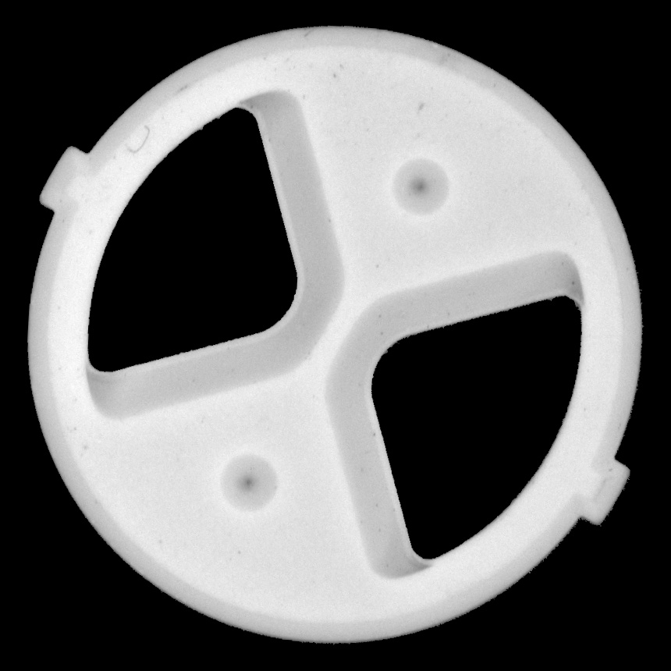
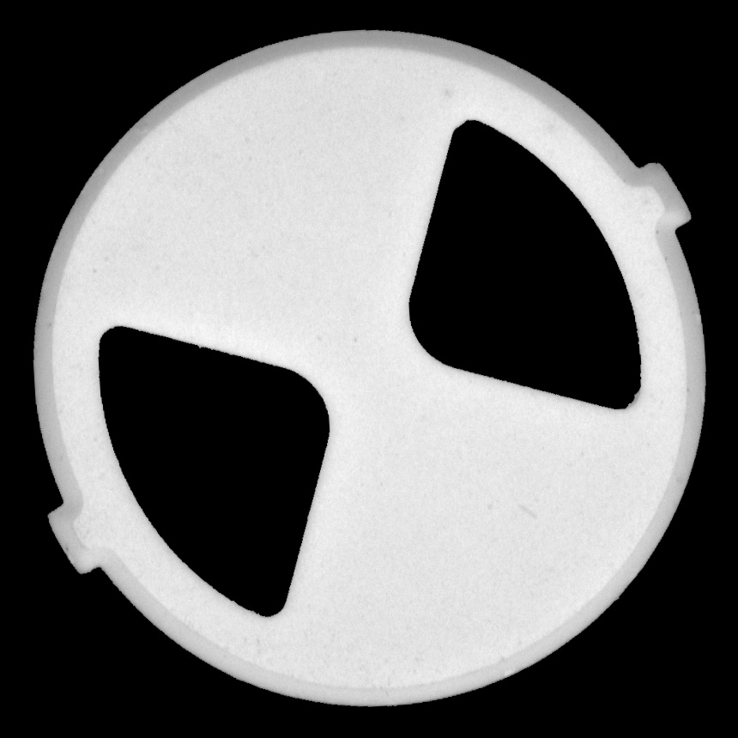
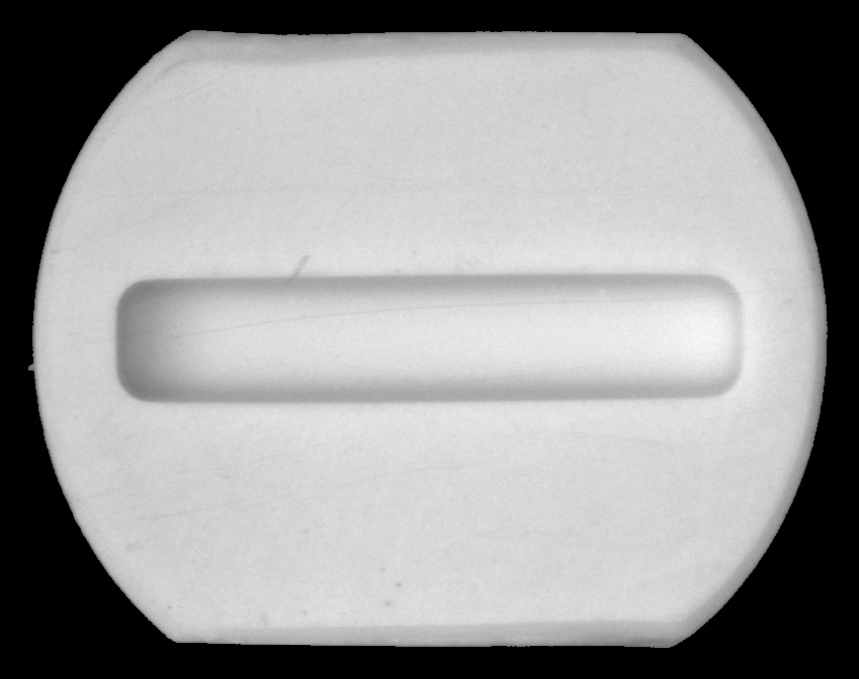
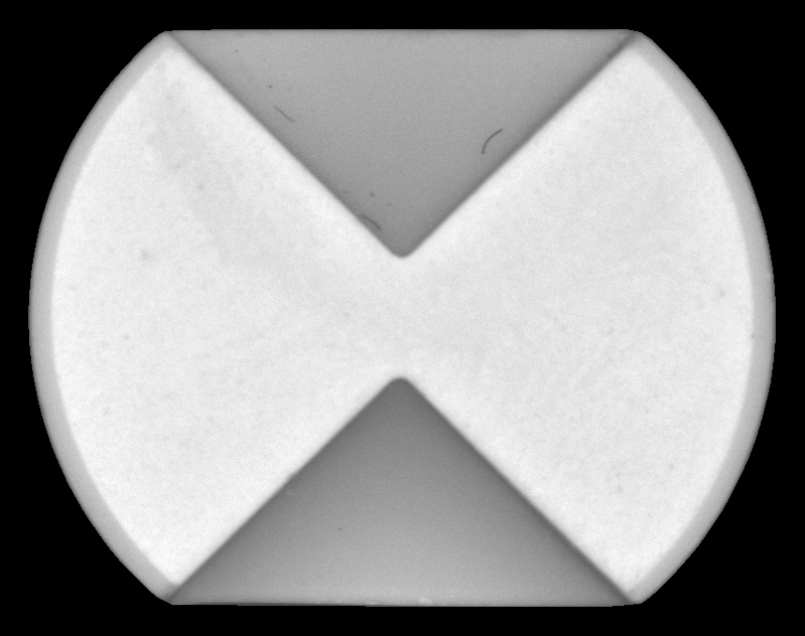
Introduction
140C back
740*570 pixels
140C front
140N back
140N front
740*740 pixels
KNT1 back
KNT1 front
KNT2 back
KNT2 front
860*860 pixels
860*680 pixels

Slide 6
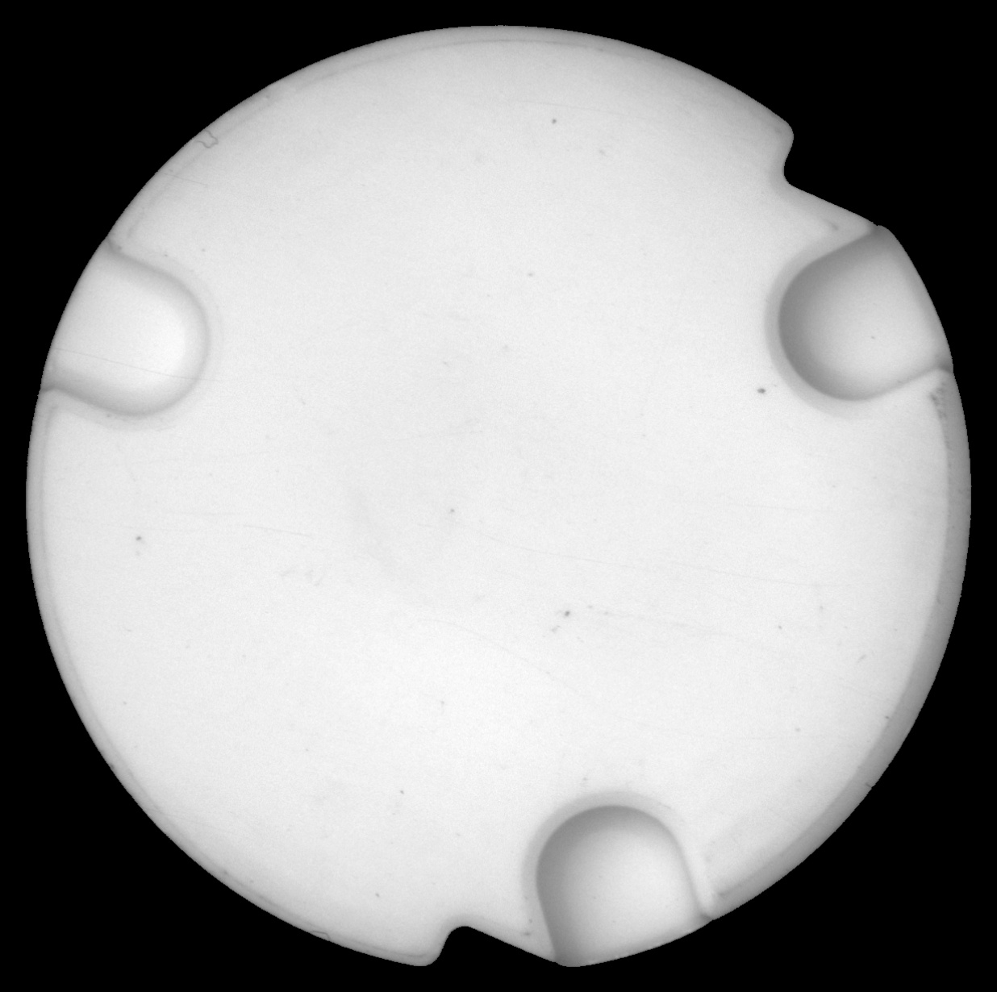
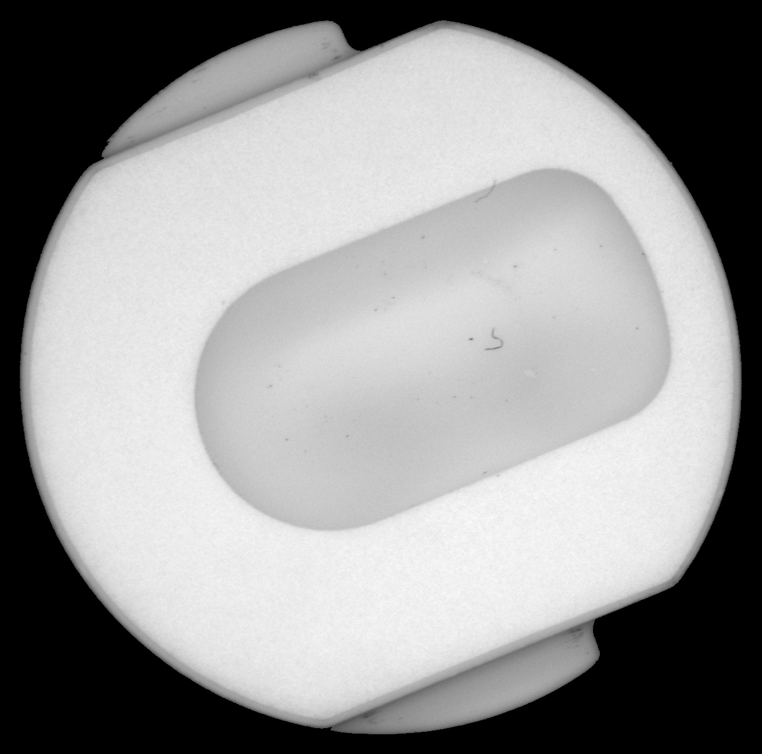
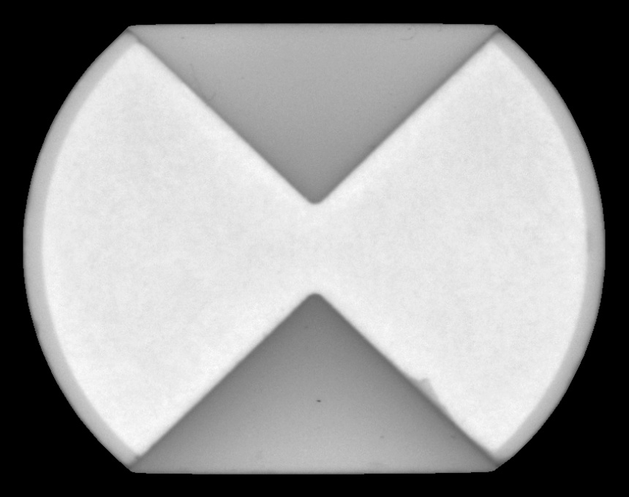
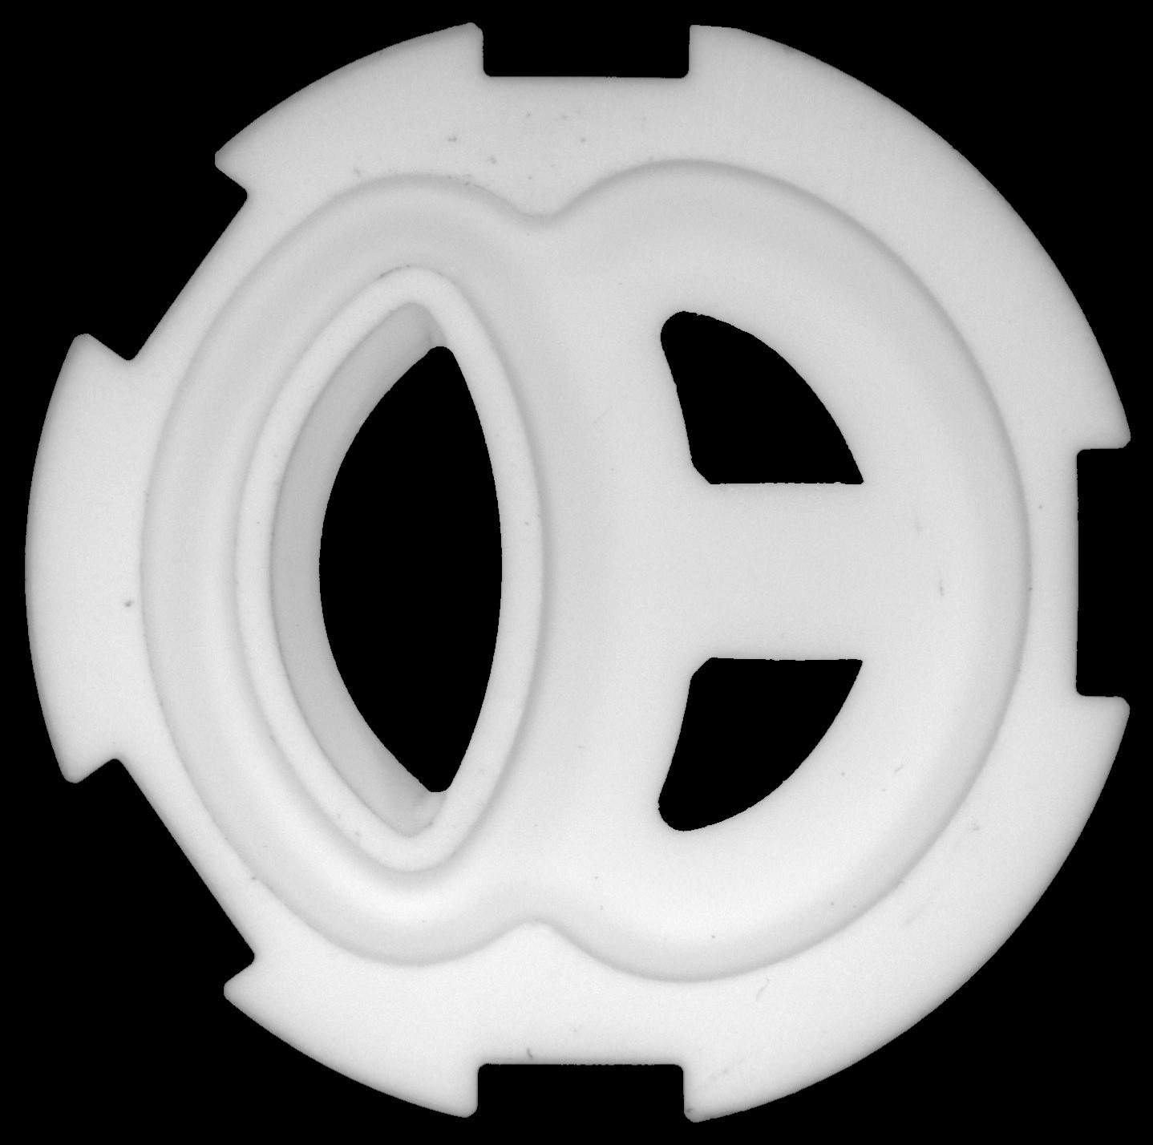
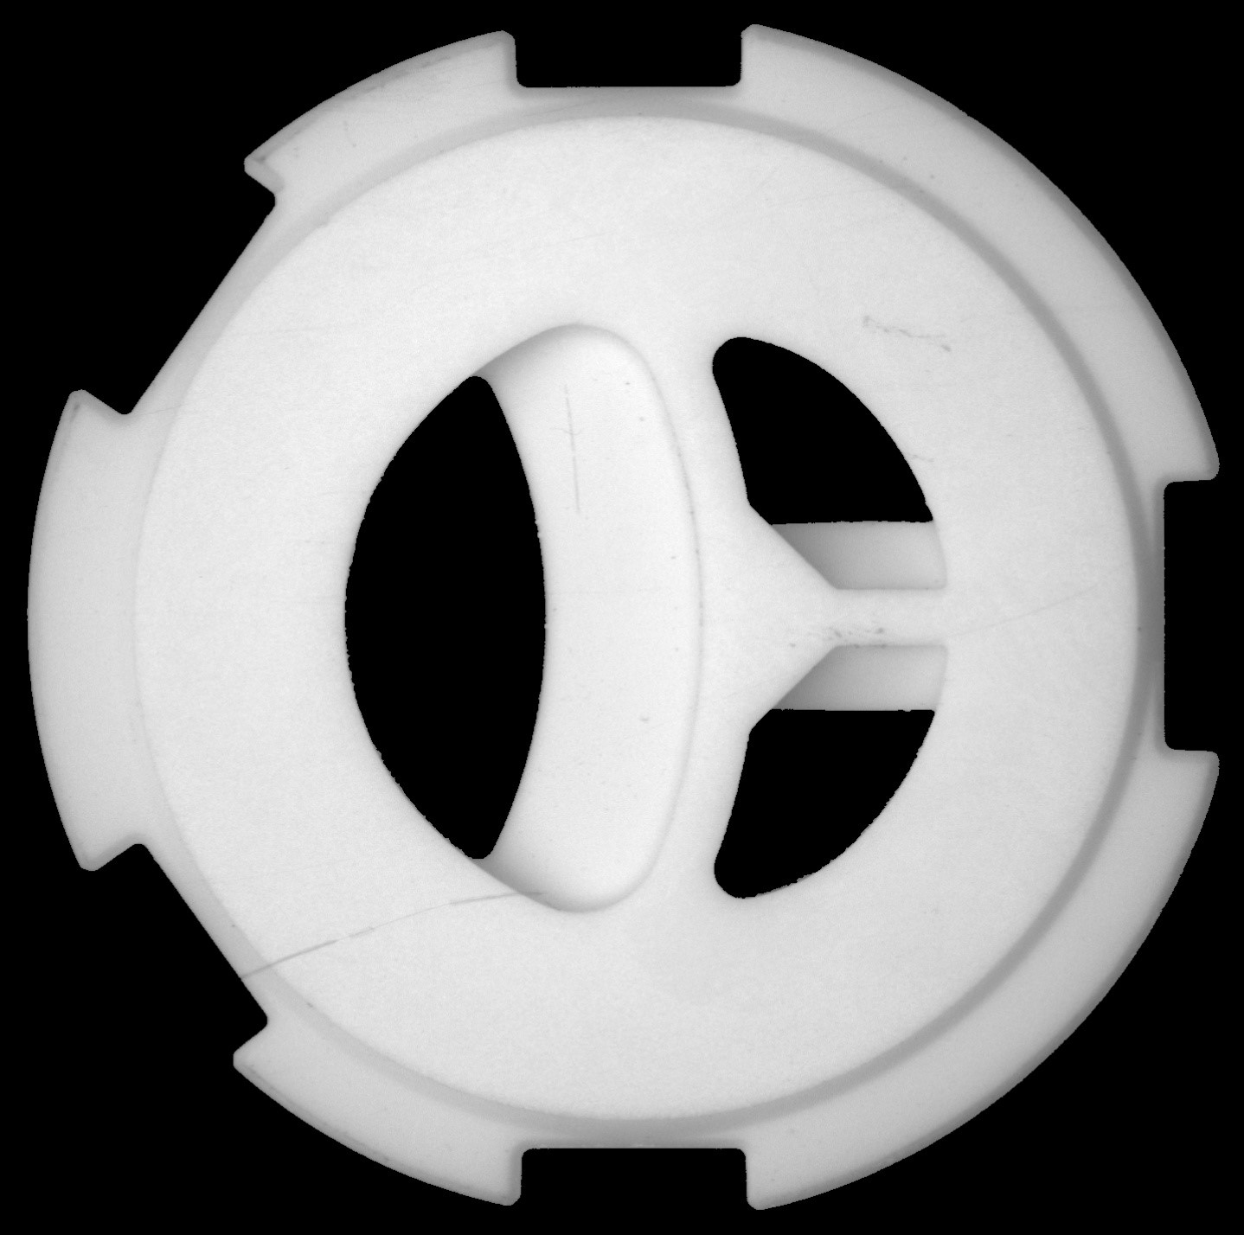
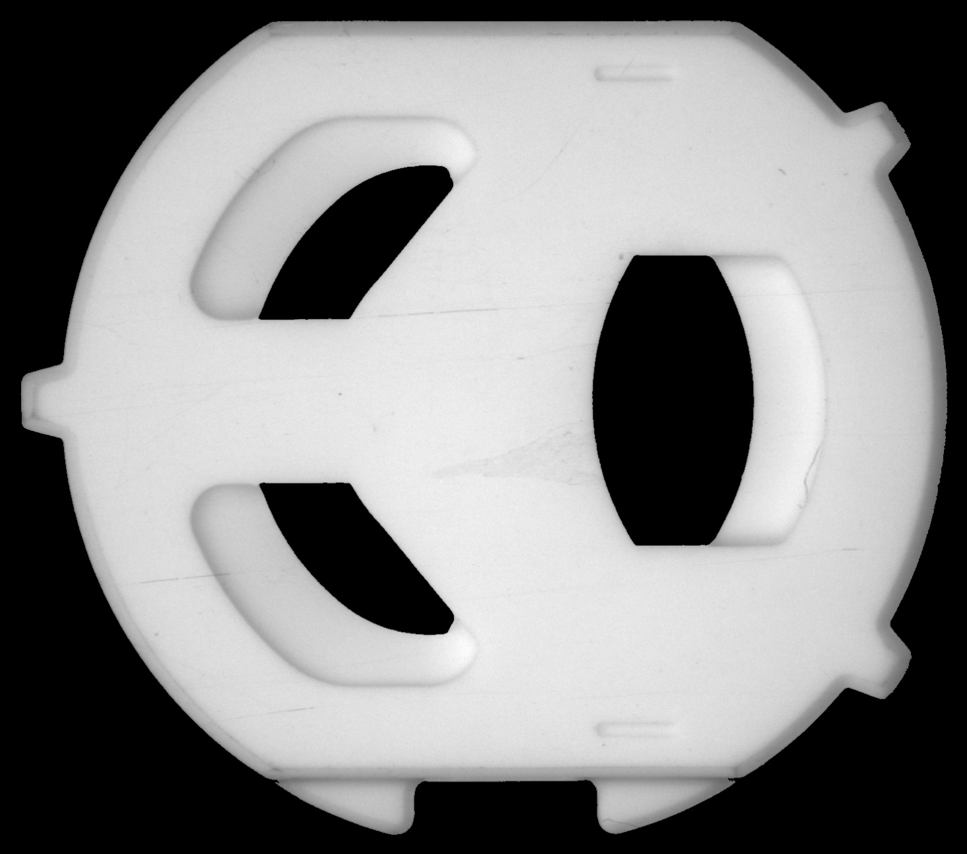
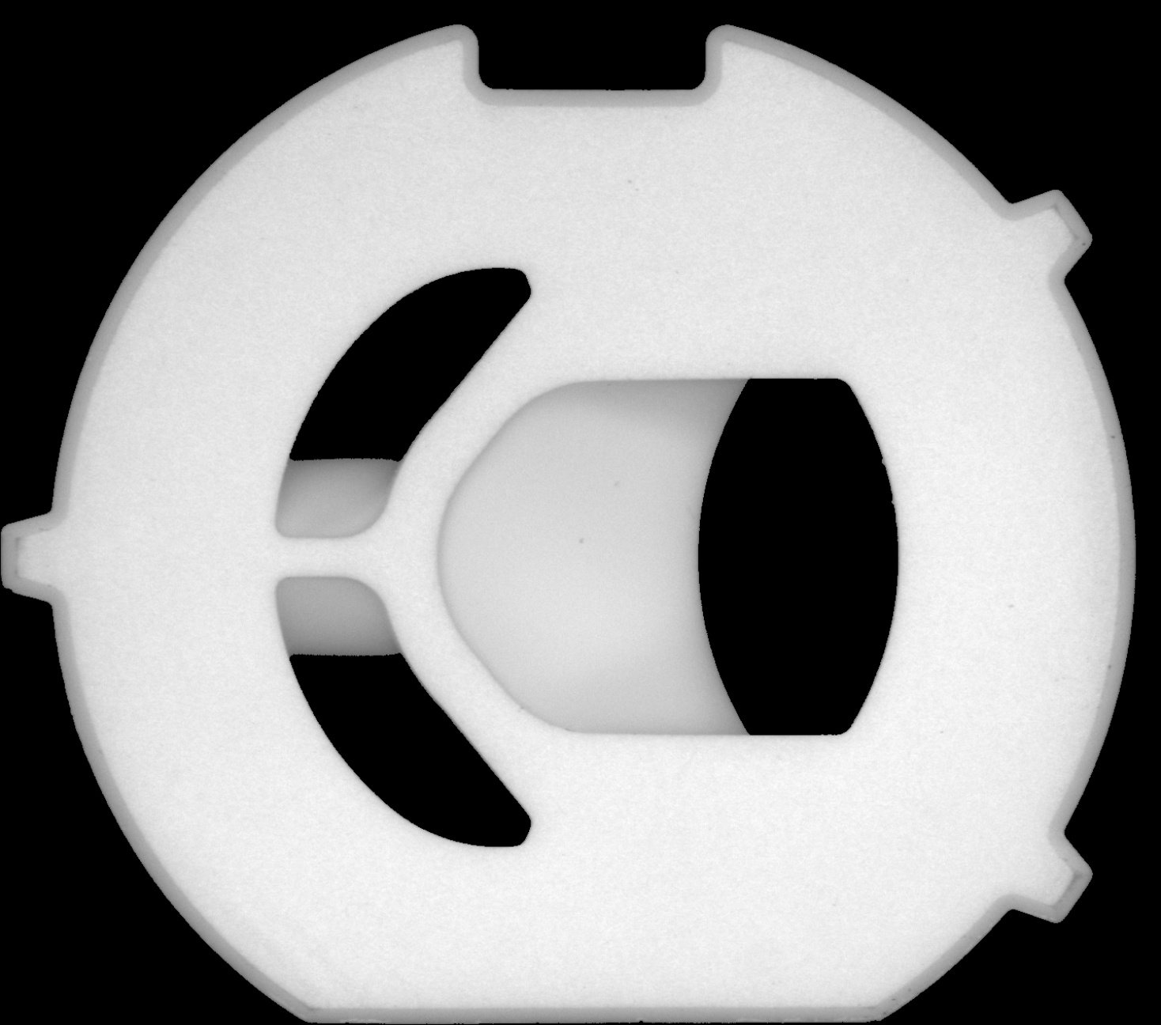
Introduction
YNT2 back
YNT2 front
M38N back
M38N front
860*680 pixels
1,236*1,230 pixels
M89F back
M89F front
D68F back
D68F front
1,468*1,296 pixels
1,438*1,428 pixels

Slide 7
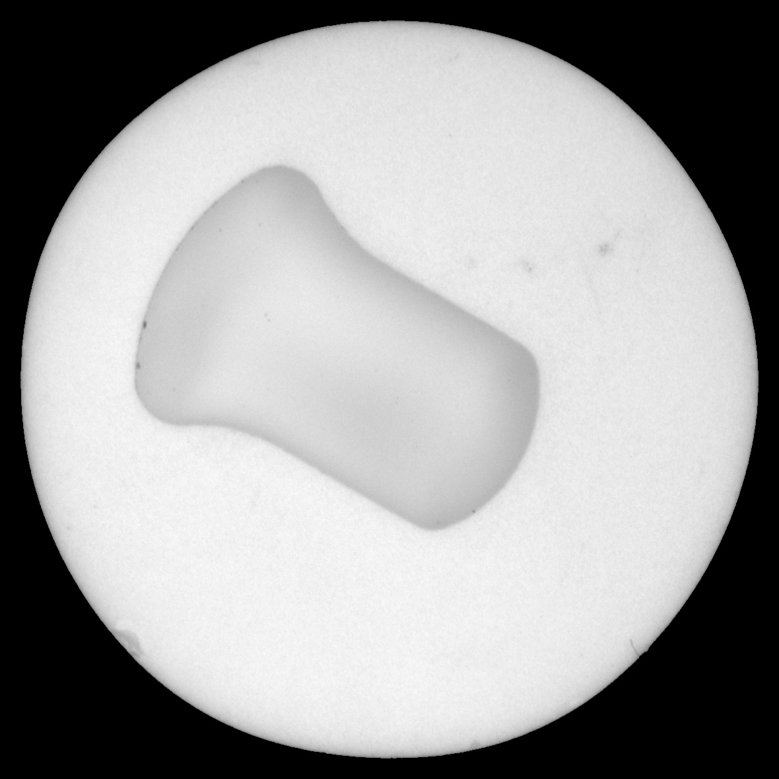
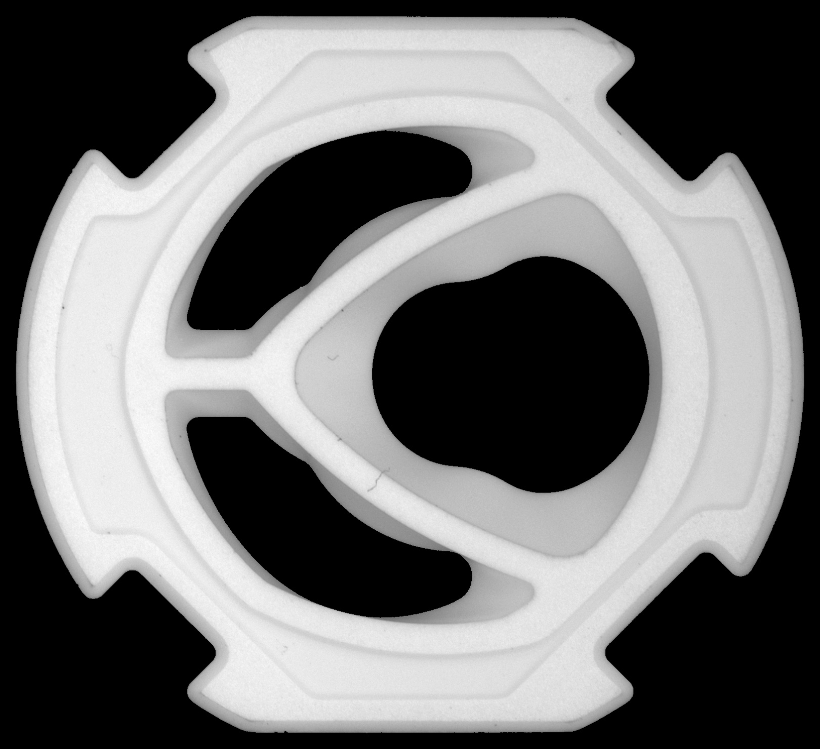
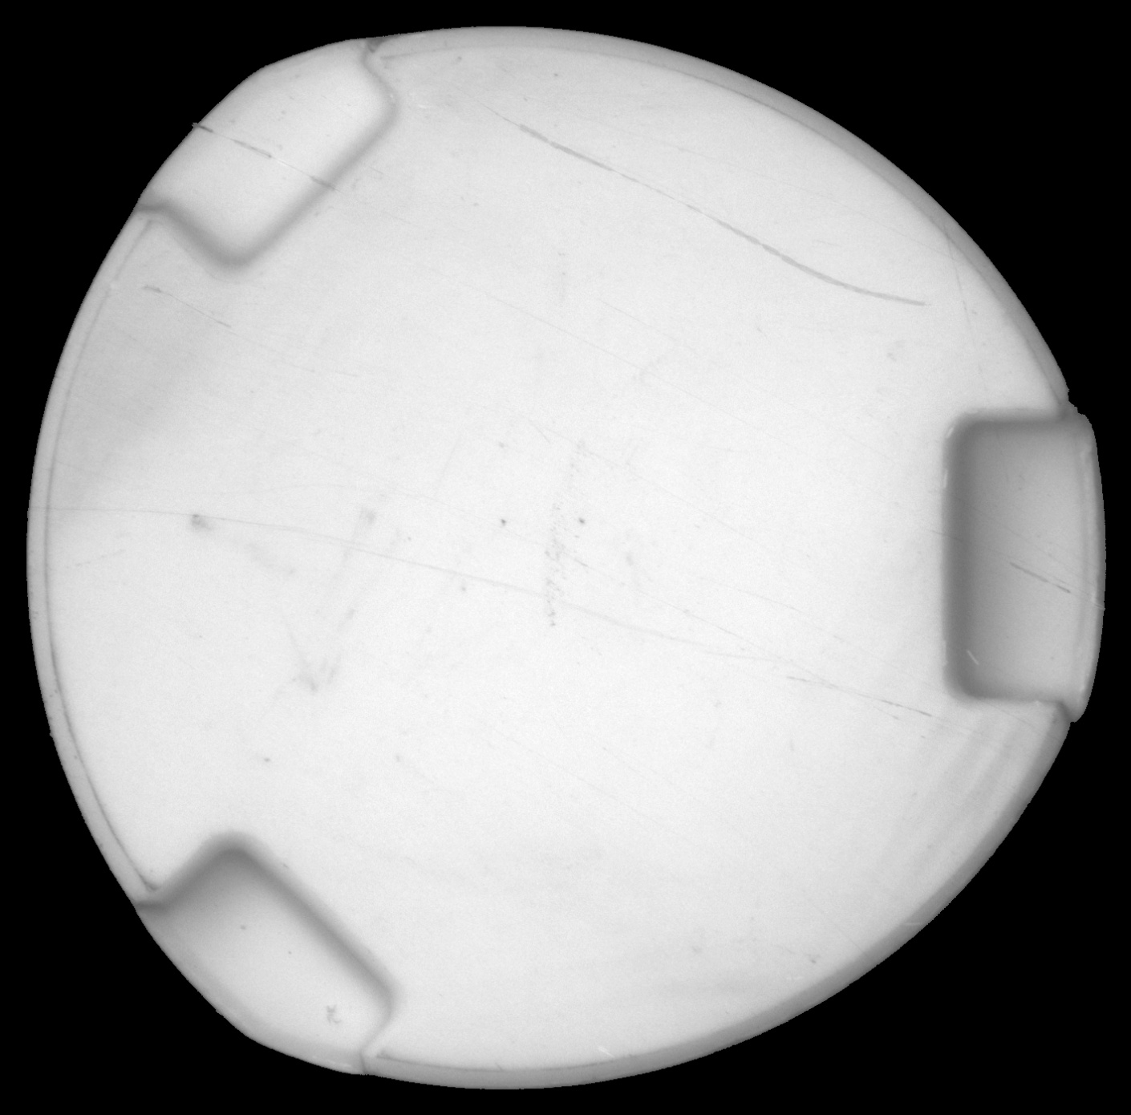
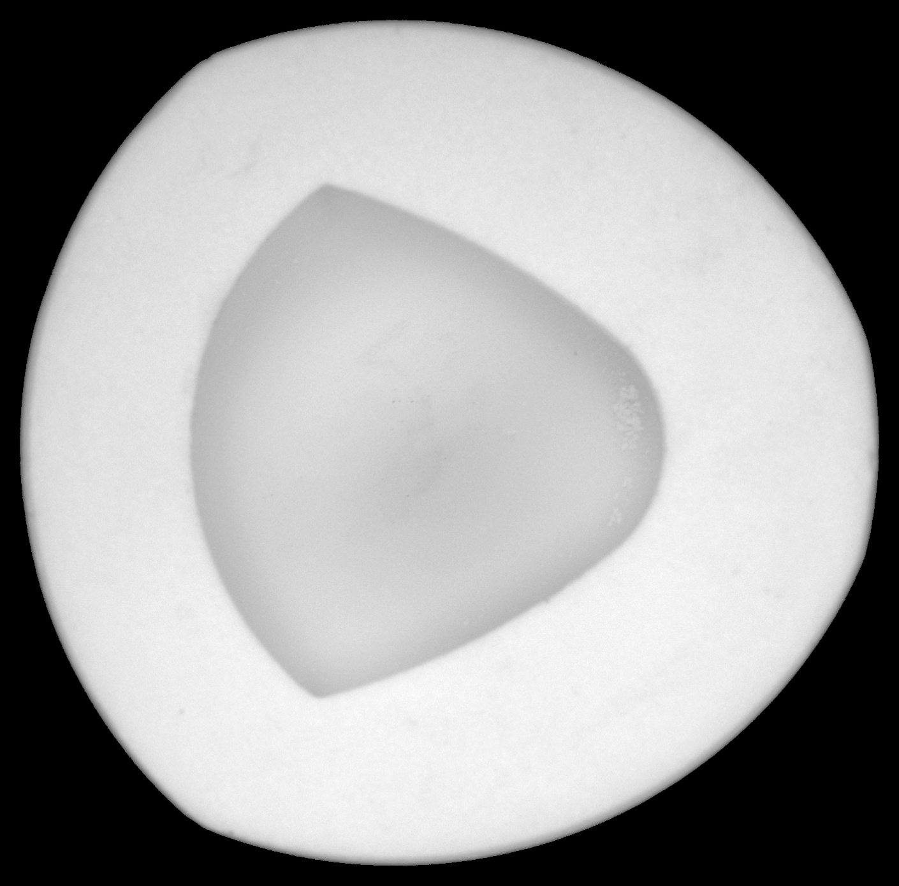
Introduction
D69M back
D69M front
P35F back
P35F front
1,190*1,183 pixels
1,620*1,480 pixels
P35M back
1,410*1,390 pixels
P35M front

Slide 8
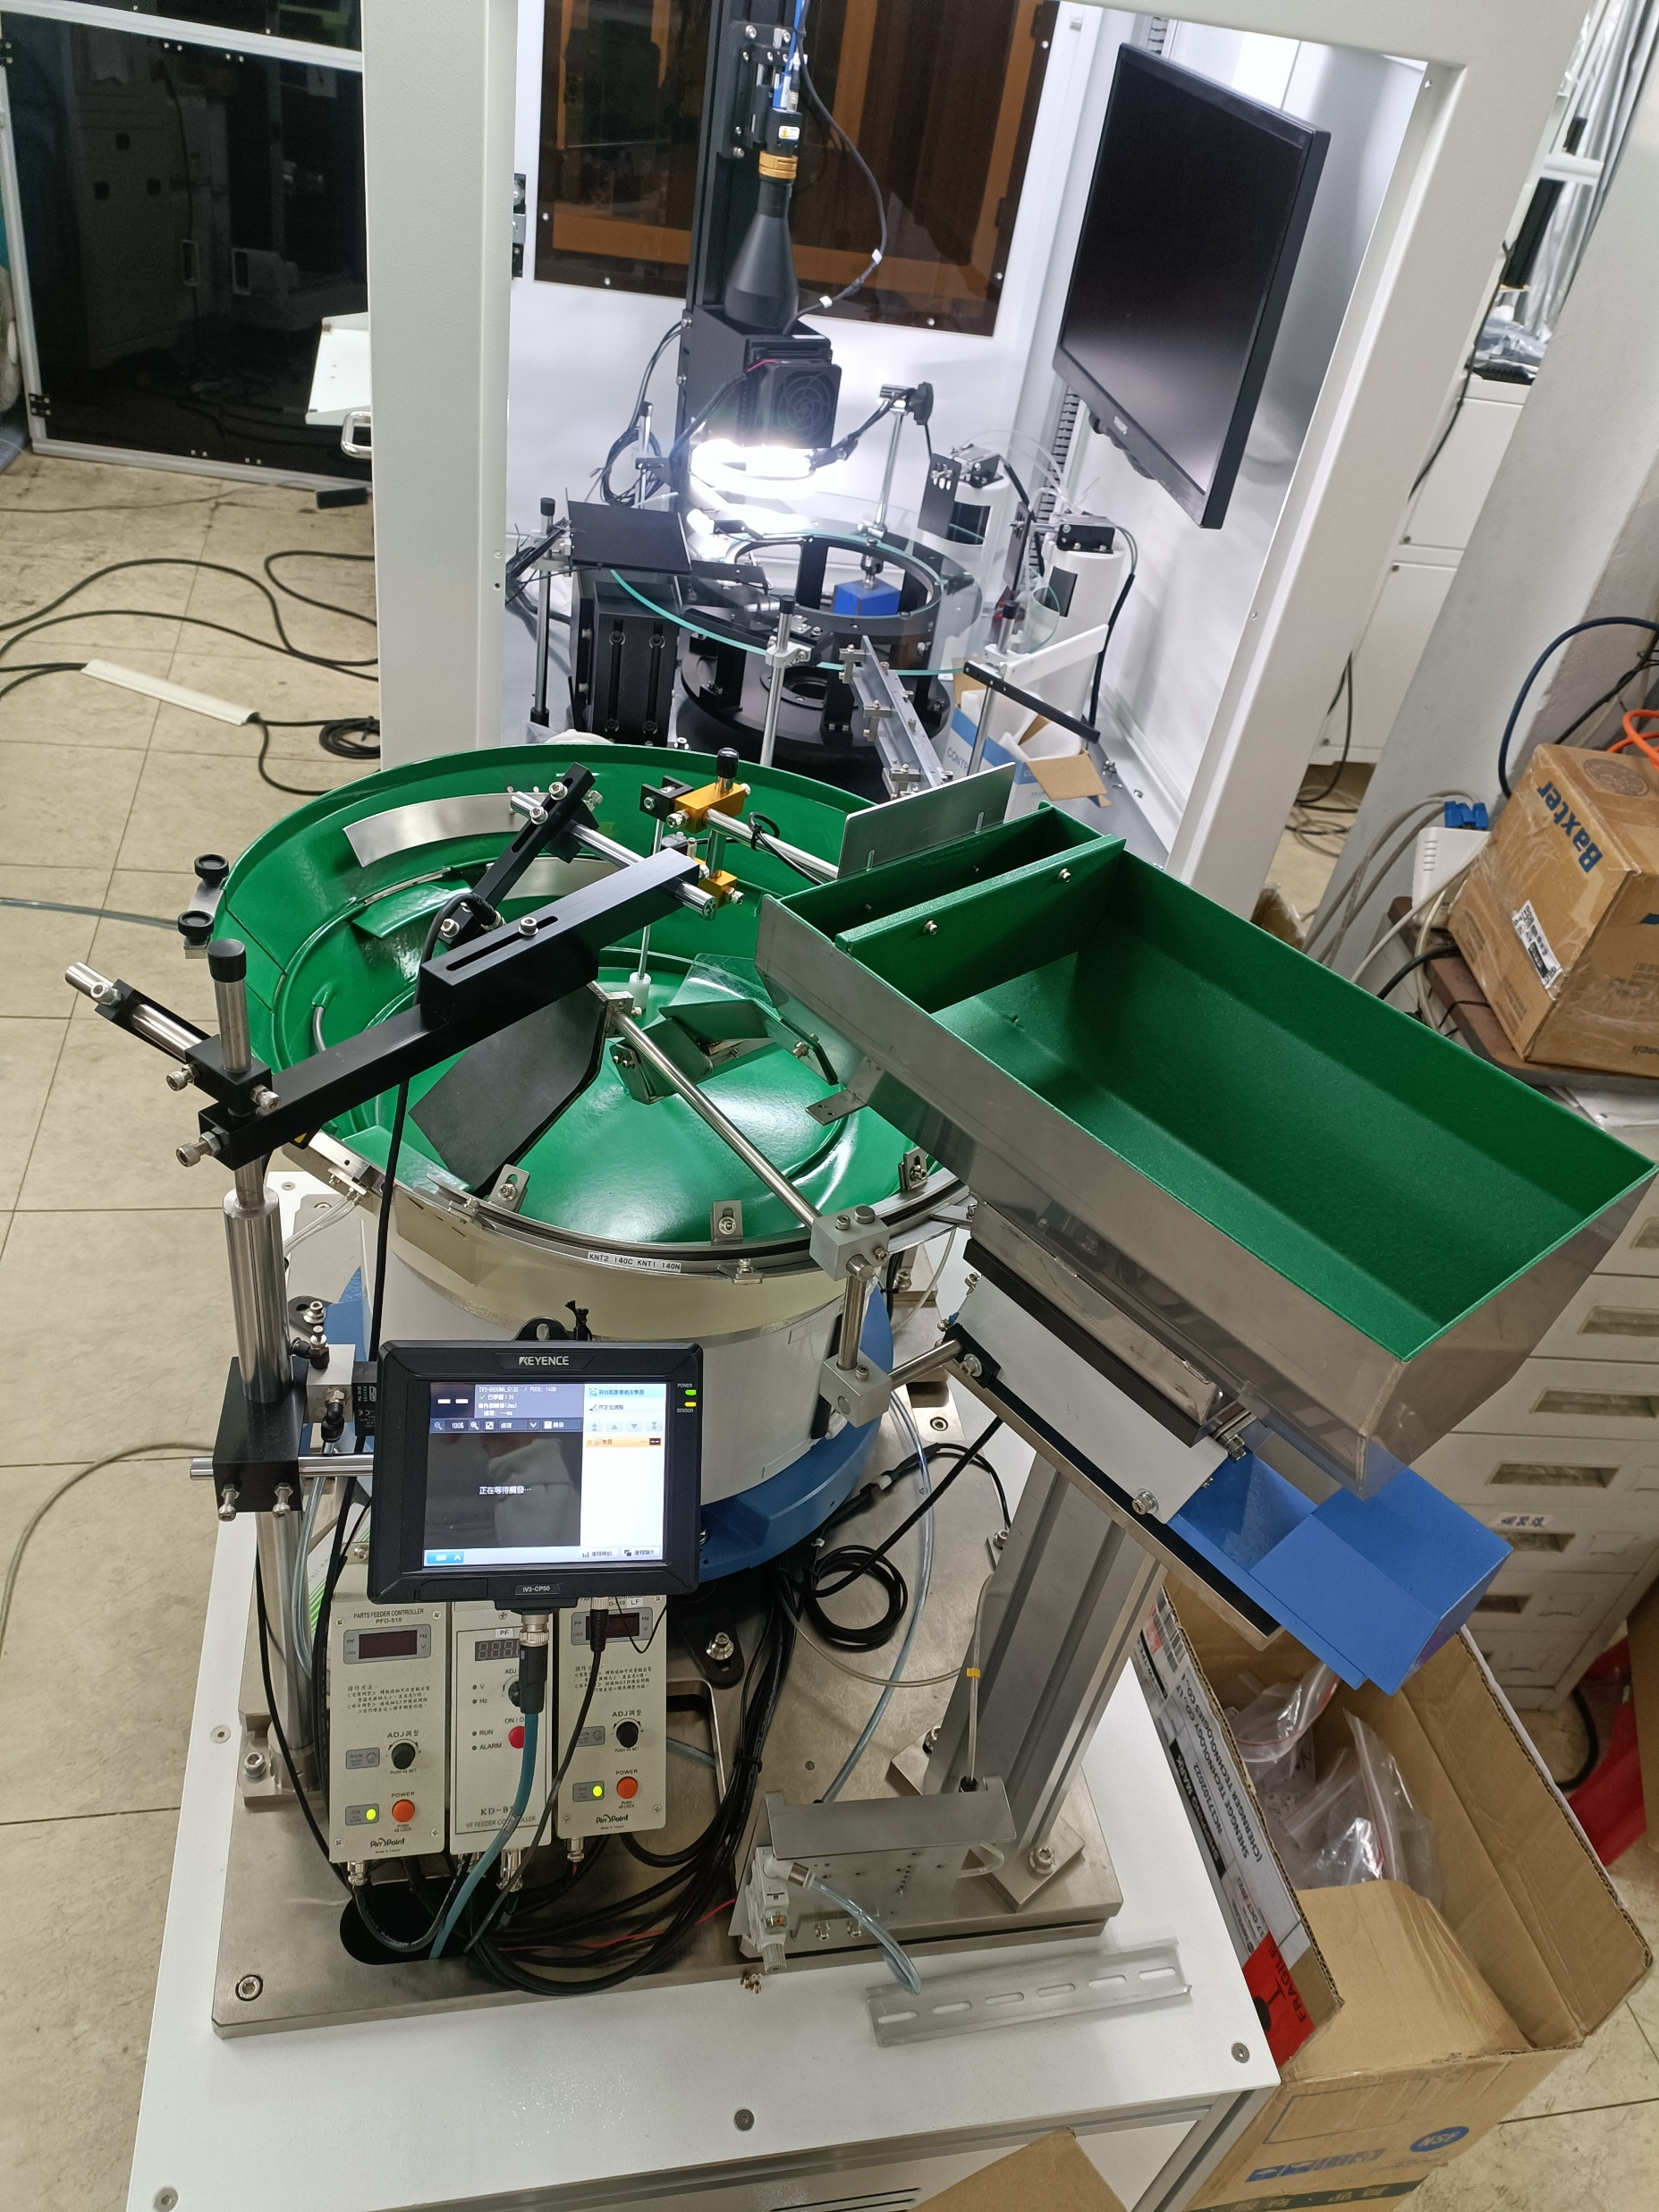
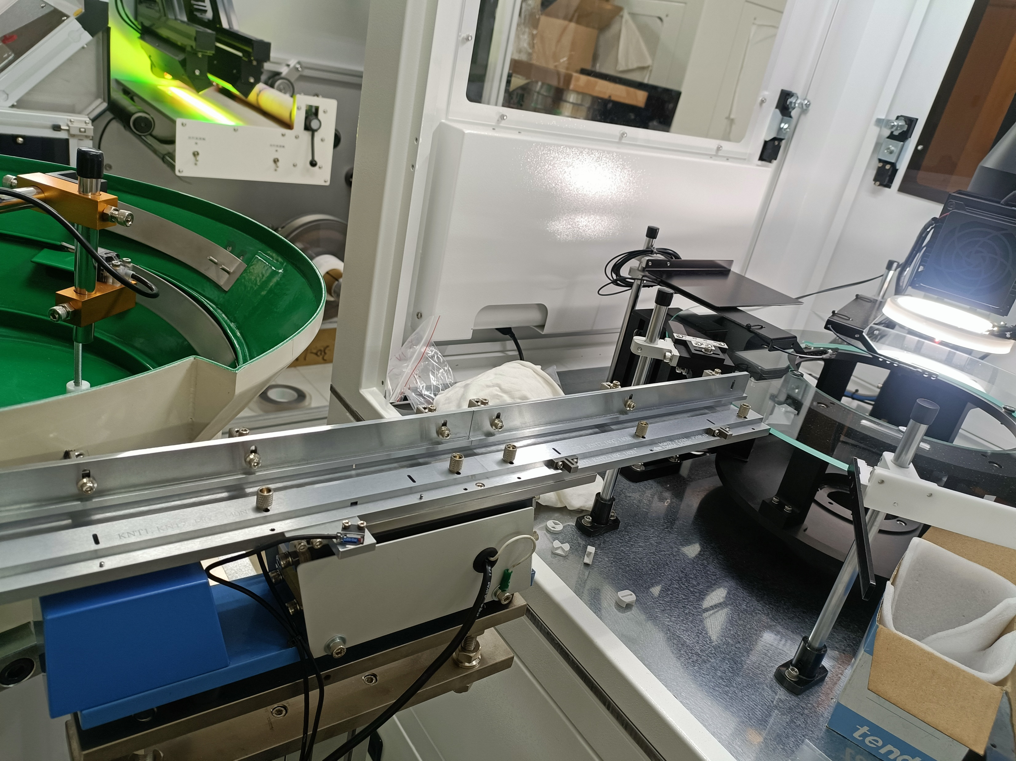
Environment

Slide 9
Environment
Second side for front part
OK
First side for back part
NG
NULL

Slide 10
Demonstration

Slide 11
Process: All Process
GUI: Graphical User Interface
AI: Artificial Intelligence
PLC: Programmable Logic Controller
Put Valve Core on Vibrating Plate
AI Decides if Reverse
First Side Decides if OK
Second Side Decides if OK
Push Them on Right Site
PLC Control
User Sets GUI

Slide 12
Process: All Process
GUI: Graphical User Interface
AI: Artificial Intelligence
PLC: Programmable Logic Controller
Put Valve Core on Vibrating Plate
AI Decides if Reverse
First Side Decides if OK
Second Side Decides if OK
Push Them on Right Site
PLC Control
User Sets GUI

Slide 13
Process: GUI

Slide 14
Process: All Process
GUI: Graphical User Interface
AI: Artificial Intelligence
PLC: Programmable Logic Controller
Put Valve Core on Vibrating Plate
AI Decides if Reverse
First Side Decides if OK
Second Side Decides if OK
Push Them on Right Site
PLC Control
User Sets GUI

Slide 15
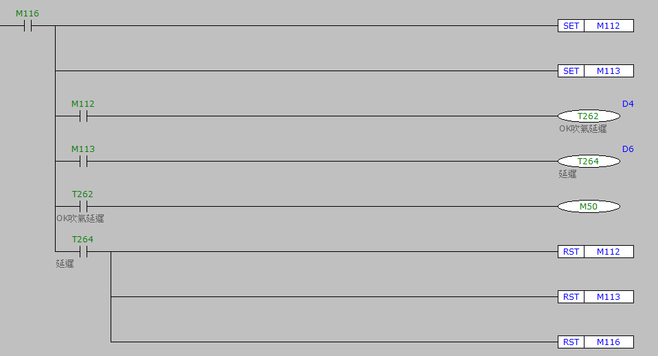
Process: PLC

Slide 16
Process: All Process
GUI: Graphical User Interface
AI: Artificial Intelligence
PLC: Programmable Logic Controller
Put Valve Core on Vibrating Plate
AI Decides if Reverse
First Side Decides if OK
Second Side Decides if OK
Push Them on Right Site
PLC Control
User Sets GUI

Slide 17
Process: Data Preprocess by Traditional Algorithm
Original Image
Gaussian Blur
Threshold
Ellipse
Erode
Dilate
Max Contour
Rotate and Rectangle
Original Image Rotates
Crop
Decide if no Lapping
Image Enhancement
Check if Reverse
Background Removal
Uniform Image Height Greater than Width

Slide 18
Process: Data Preprocess by Traditional Algorithm
Original Image
Gaussian Blur
Threshold
Ellipse
Erode
Dilate
Max Contour
Rotate and Rectangle
Original Image Rotates
Crop
Decide if no Lapping
Image Enhancement
Check if Reverse
Background Removal
Uniform Image Height Greater than Width

Slide 19
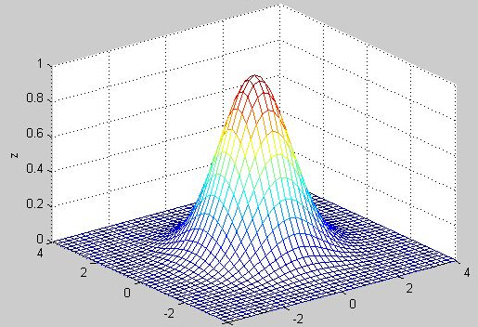
Gaussian Blur
σ = 1
Before
Kernel Size 9x9 Pixels
After

Slide 20
Process: Data Preprocess by Traditional Algorithm
Original Image
Gaussian Blur
Threshold
Ellipse
Erode
Dilate
Max Contour
Rotate and Rectangle
Original Image Rotates
Crop
Decide if no Lapping
Image Enhancement
Check if Reverse
Background Removal
Uniform Image Height Greater than Width

Slide 21
Threshold
Before
After

Slide 22
Process: Data Preprocess by Traditional Algorithm
Original Image
Gaussian Blur
Threshold
Ellipse
Erode
Dilate
Max Contour
Rotate and Rectangle
Original Image Rotates
Crop
Decide if no Lapping
Image Enhancement
Check if Reverse
Background Removal
Uniform Image Height Greater than Width

Slide 23
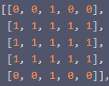
Ellipse
Before
After

Slide 24
Process: Data Preprocess by Traditional Algorithm
Original Image
Gaussian Blur
Threshold
Ellipse
Erode
Dilate
Max Contour
Rotate and Rectangle
Original Image Rotates
Crop
Decide if no Lapping
Image Enhancement
Check if Reverse
Background Removal
Uniform Image Height Greater than Width

Slide 25
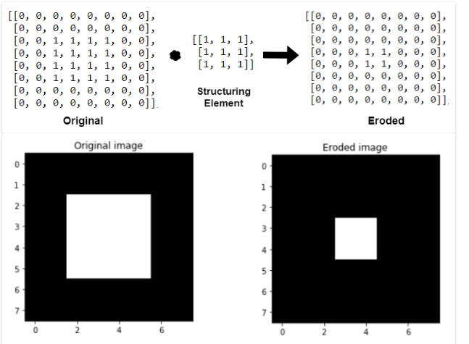
Erode
Before
After

Slide 26
Process: Data Preprocess by Traditional Algorithm
Original Image
Gaussian Blur
Threshold
Ellipse
Erode
Dilate
Max Contour
Rotate and Rectangle
Original Image Rotates
Crop
Decide if no Lapping
Image Enhancement
Check if Reverse
Background Removal
Uniform Image Height Greater than Width

Slide 27
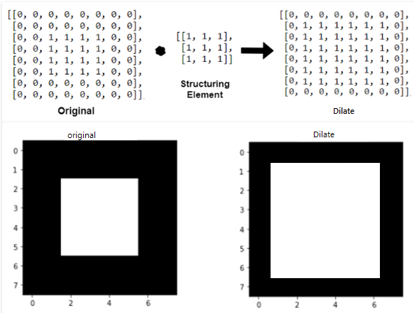
Dilate
Before
After

Slide 28
Process: Data Preprocess by Traditional Algorithm
Original Image
Gaussian Blur
Threshold
Ellipse
Erode
Dilate
Max Contour
Rotate and Rectangle
Original Image Rotates
Crop
Decide if no Lapping
Image Enhancement
Check if Reverse
Background Removal
Uniform Image Height Greater than Width

Slide 29
Rotate and Rectangle
Before
After

Slide 30
Process: Data Preprocess by Traditional Algorithm
Original Image
Gaussian Blur
Threshold
Ellipse
Erode
Dilate
Max Contour
Rotate and Rectangle
Original Image Rotates
Crop
Decide if no Lapping
Image Enhancement
Check if Reverse
Background Removal
Uniform Image Height Greater than Width

Slide 31
Rotate Original Image
Before
After

Slide 32
Process: Data Preprocess by Traditional Algorithm
Original Image
Gaussian Blur
Threshold
Ellipse
Erode
Dilate
Max Contour
Rotate and Rectangle
Original Image Rotates
Crop
Decide if no Lapping
Image Enhancement
Check if Reverse
Background Removal
Uniform Image Height Greater than Width

Slide 33
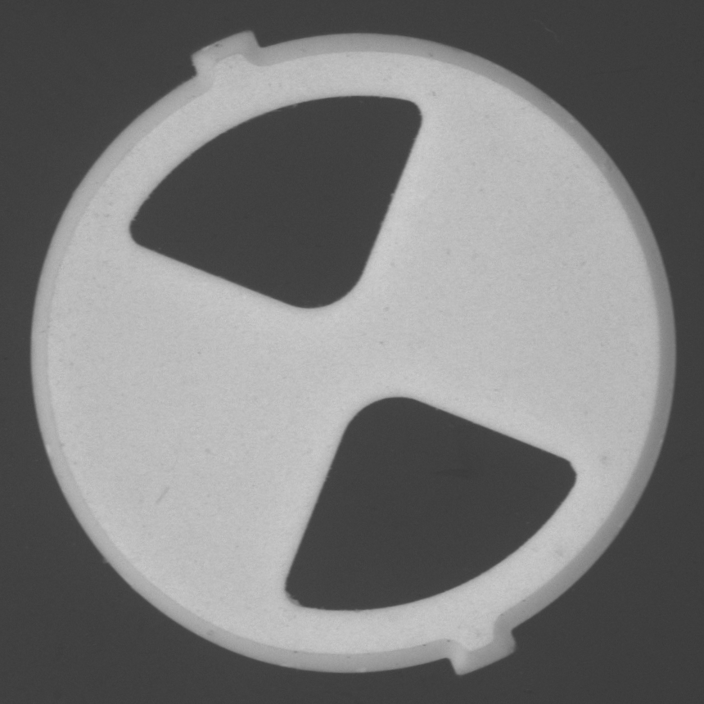
Crop
+
=

Slide 34
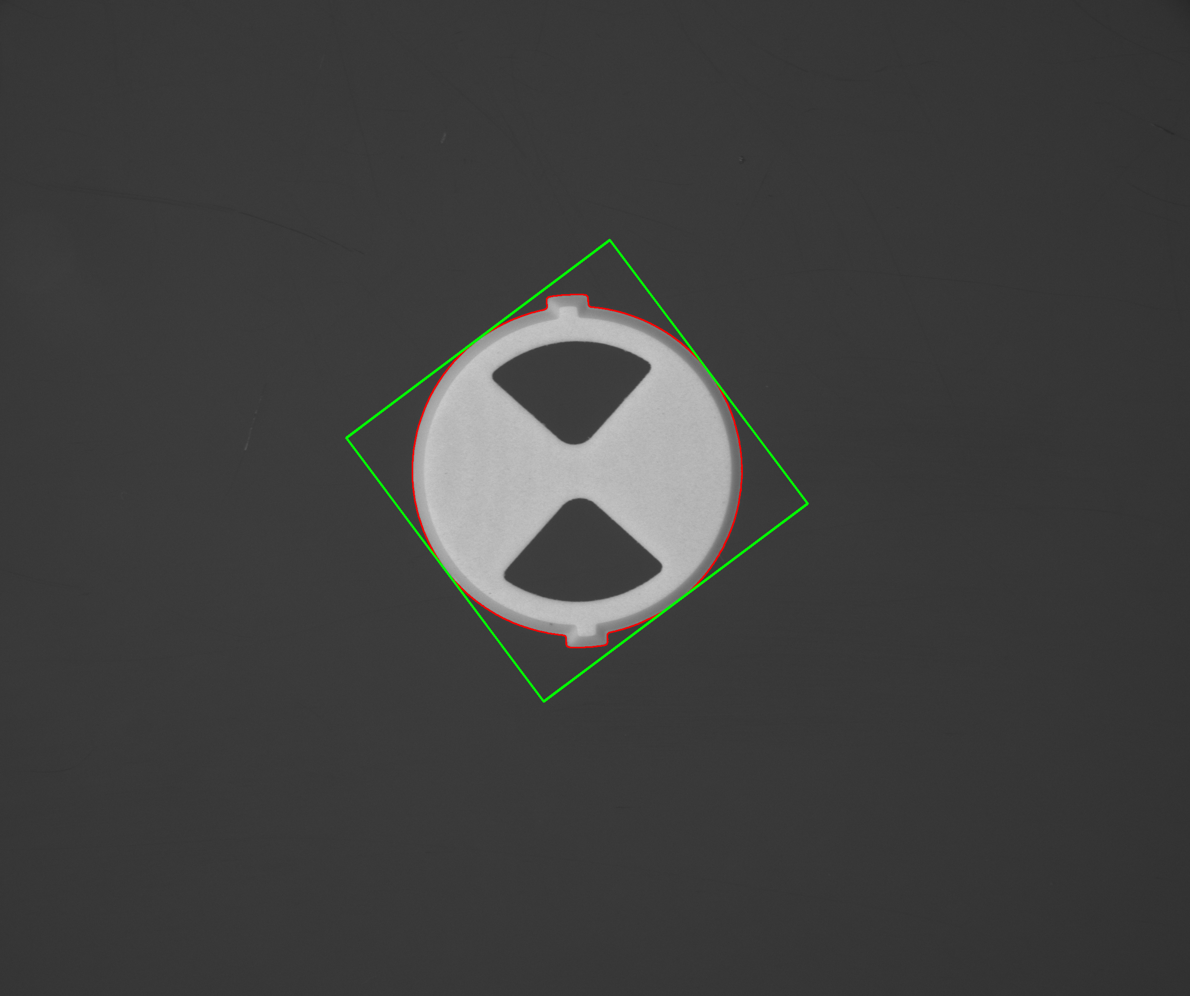
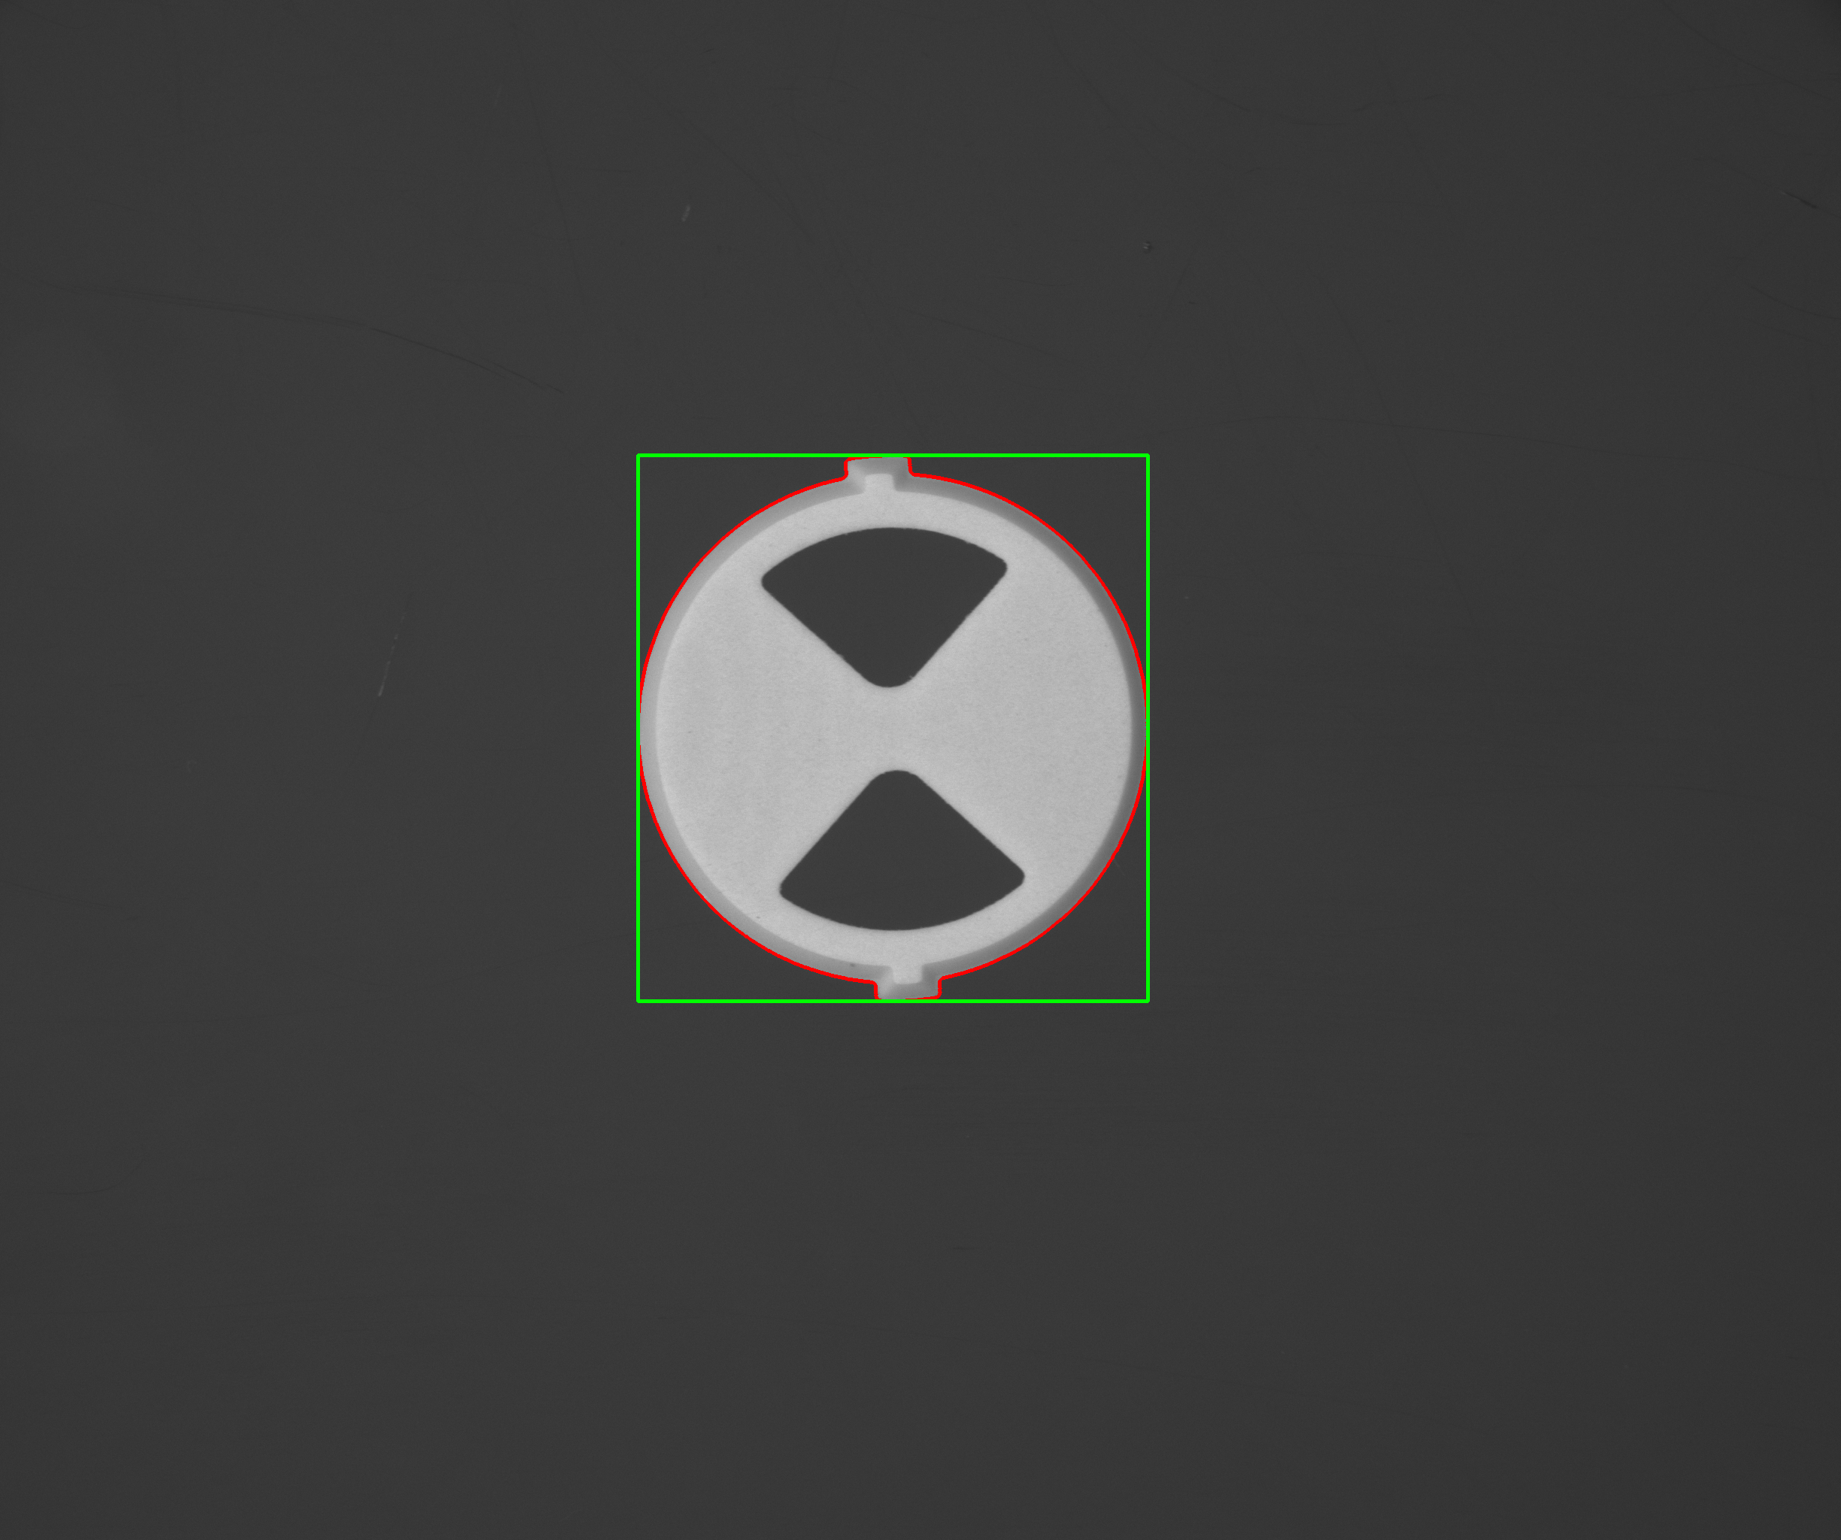
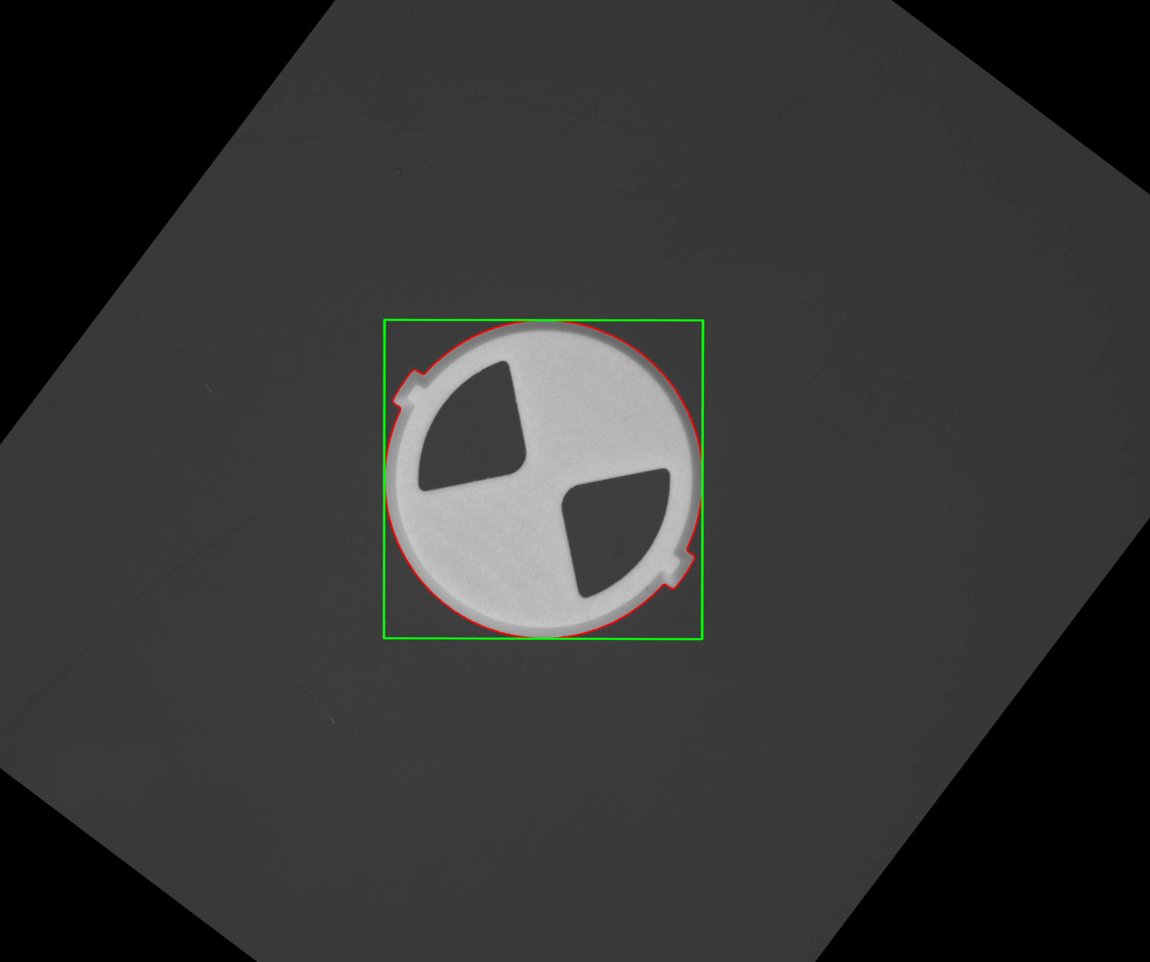
Why Need to Double Rotate
MinAreaRect
BoundingRect
BoundingRect
MinAreaRect

Slide 35
Process: Data Preprocess by Traditional Algorithm
Original Image
Gaussian Blur
Threshold
Ellipse
Erode
Dilate
Max Contour
Rotate and Rectangle
Original Image Rotates
Crop
Decide if no Lapping
Image Enhancement
Check if Reverse
Background Removal
Uniform Image Height Greater than Width

Slide 36
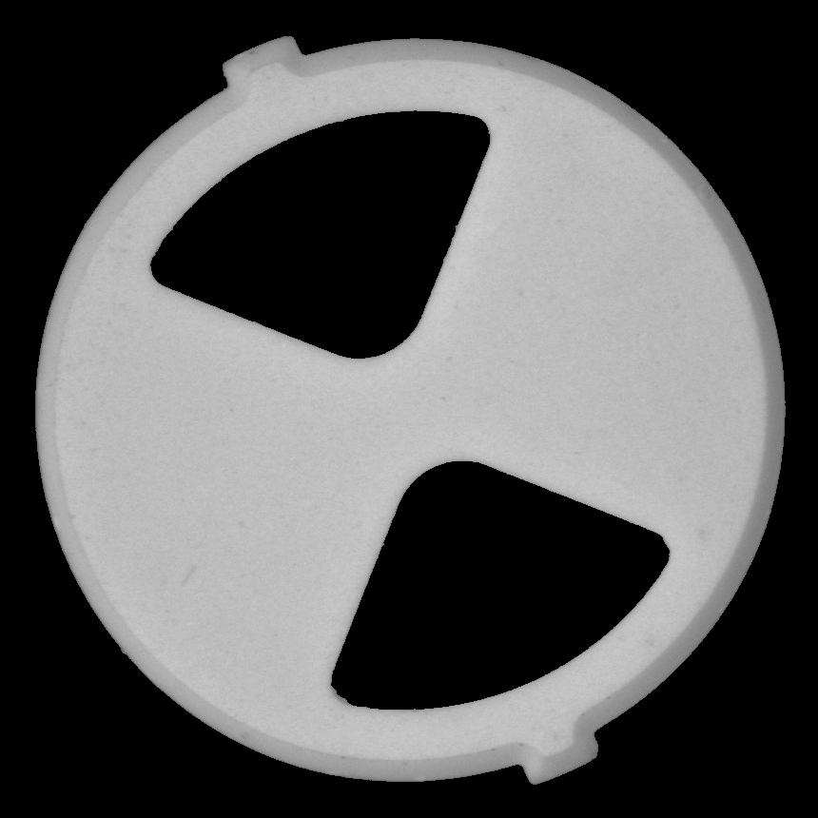
Background Removal
+
=

Slide 37
Process: Data Preprocess by Traditional Algorithm
Original Image
Gaussian Blur
Threshold
Ellipse
Erode
Dilate
Max Contour
Rotate and Rectangle
Original Image Rotates
Crop
Decide if no Lapping
Image Enhancement
Check if Reverse
Background Removal
Uniform Image Height Greater than Width

Slide 38
Uniform Image Height Greater than Width

Slide 39
Process: Data Preprocess by Traditional Algorithm
Original Image
Gaussian Blur
Threshold
Ellipse
Erode
Dilate
Max Contour
Rotate and Rectangle
Original Image Rotates
Crop
Decide if no Lapping
Image Enhancement
Check if Reverse
Background Removal
Uniform Image Height Greater than Width

Slide 40
Decide if no Lapping
By the Mean of Pixel Value
Good
No Lapping

Slide 41
Process: Data Preprocess by Traditional Algorithm
Original Image
Gaussian Blur
Threshold
Ellipse
Erode
Dilate
Max Contour
Rotate and Rectangle
Original Image Rotates
Crop
Decide if no Lapping
Image Enhancement
Check if Reverse
Background Removal
Uniform Image Height Greater than Width

Slide 42
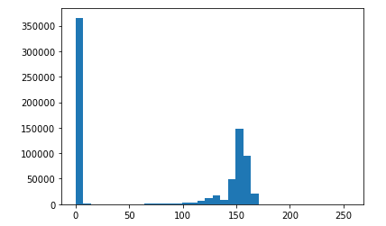
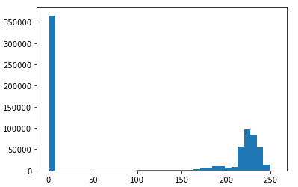
Image Enhancement
Before
After

Slide 43
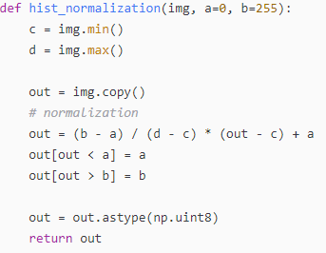
Image Enhancement
Omin, Omax = 0, 255
Maximg: maximal pixel value of picture
Minimg: least pixel value of picture
a = float (Omax - Omin)/ (Maximg - Minimg)
b = Omin - a* Minimg
O = a*img + b
Minimg: Minimum Object Intensity Excluding Background

Slide 44
Process: Data Preprocess by Traditional Algorithm
Original Image
Gaussian Blur
Threshold
Ellipse
Erode
Dilate
Max Contour
Rotate
Original Image Rotates
Crop
Decide if no Lapping
Image Enhancement
Check if Reverse
Background Removal
Uniform Image Height Greater than Width

Slide 45
Check if Reverse (140C)
Normal
Reverse

Slide 46
Check if Reverse (140N)
Normal
Reverse

Slide 47
Check if Reverse (D69M)
Normal
Reverse

Slide 48
Check if Reverse (P35F)
Normal
Reverse

Slide 49
Process: AI Part
YOLO: You Only Look Once
HSV: Hue, Saturation, Value
Preprocessed Image
Anomalib
HSV
Chipping
If YOLO Detect
Compute Size
YOLOv5
Spot
Compute Size
Crack
Compute Size

Slide 50
Process: AI Part
YOLO: You Only Look Once
HSV: Hue, Saturation, Value
Preprocessed Image
Anomalib
HSV
Chipping
If YOLO Detect
Compute Size
YOLOv5
Spot
Compute Size
Crack
Compute Size

Slide 51
Process: AI Part Anomalib
The library has a strong focus on image-based anomaly detection, where the goal of the algorithm is to identify anomalous images, or anomalous pixel regions within images in a dataset.

Slide 52
Process: AI Part Anomalib
This unsupervised nature of anomaly detection makes it well suited for real-world applications such as industrial, medical and security, where a clearly defined anomalous class is often lacking.
Anomalib is a unified library that provides a set of components and tools that could be used in anomaly detection research and production.
Notes:
非監督式學習 獨特的套件用來瑕疵檢測

Slide 53
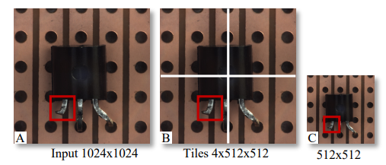
Process: AI Part Anomalib
CIFAR: Canadian Institute For Advanced Research
BTAD: Bean Tech Anomaly Detection
NNCF: Neural Network Compression Framework
OpenVINO: Open Visual Inference and Neural network Optimization
HPO: Hyper Parameter Optimization
min-max normalization
Tiling: optionally dividing the images into (non-)overlapping tiles.
Transforms: Anomalib utilizes the albumentations library for image transformations.

Slide 54
Process: AI Part Anomalib
PaDiM: Patch Distribution Modeling Framework for Anomaly Detection and Localization.
Each patch position is described by a multivariate Gaussian distribution.
PaDiM takes into account the correlations between different semantic levels of a pretrained CNN.
We choose as pretrained networks a ResNet. PaDiM outperforms the current state-of-the-art methods. Moreover, its time complexity is low and independent of the training dataset size at the prediction stage.
Notes:
片段分布模型網路
每個片有多個高斯
計算相關性
時間複雜度低表現最好

Slide 55
Process: AI Part Anomalib
Notes:
最後一項 full rank且可逆

Slide 56
Process: AI Part Anomalib
We use the Mahalanobis distance M(x_{ij}) to give an anomaly score to the patch in position (i, j) of a test image.
Patch embedding vectors are extracted from the first three layers when the backbone is a ResNet.

Slide 57
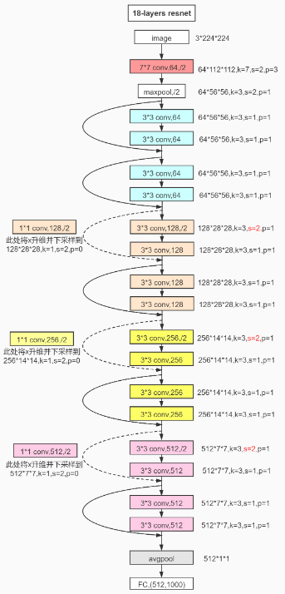
Process: AI Part Anomalib
Resnet: Residual neural network
Resnet framework

Slide 58
Process: AI Part Anomalib
AE: AutoEncoder
VAE: Variational AutoEncoder
SPADE: Semantic Pyramid Anomaly Detection
SVDD: Support Vector Data Description
AUROC: Area Under Receiver Operating Curve
PRO: Per Region Overlap
Notes:
影像重建後的誤差作為基準 特徵擷取

Slide 59
Process: AI Part Anomalib
We have presented a framework called PaDiM for anomaly detection and localization in one-class learning setting which is based on distribution modeling.
PaDiM low memory and time consumption and its ease of use make it suitable for our water valve.
Notes:
單次學習

Slide 60
Process: AI Part
YOLO: You Only Look Once
HSV: Hue, Saturation, Value
Preprocessed Image
Anomalib
HSV
Chipping
If YOLO Detect
Compute Size
YOLOv5
Spot
Compute Size
Crack
Compute Size

Slide 61
HSV
Hue: The basic property of color, for example red, yellow.
Saturation: Refers to the purity of the color, the higher the saturation, the purer the color.
Value: Brightness.
Since the output of Anomalib is a heat map, we thought HSV could find the warm color parts.

Slide 62
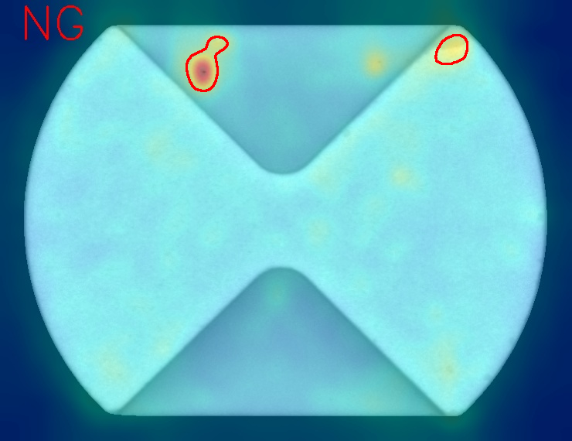
HSV
Before
After
Result

Slide 63
Process: AI Part
Preprocessed Image
Anomalib
HSV
Chipping
If YOLO Detect
Calculate size
YOLOv5
Spot
Calculate size
Crack
Calculate size

Slide 64
Process: AI Part
YOLO: You Only Look Once
HSV: Hue, Saturation, Value
Preprocessed Image
Anomalib
HSV
Chipping
If YOLO Detect
Compute Size
YOLOv5
Spot
Compute Size
Crack
Compute Size

Slide 65
Process: AI Part YOLO

Slide 66
Process: AI Part YOLO

Slide 67
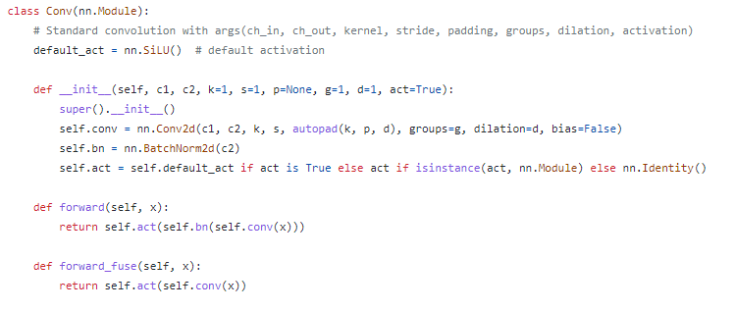
Process: AI Part YOLO
Notes:
Con + batchnorm + siLU

Slide 68
Process: AI Part YOLO

Slide 69
Process: AI Part YOLO
Notes:
它是将原本并行的 MaxPool 替换成了串行 MaxPool

Slide 70
Process: AI Part YOLO

Slide 71
Process: AI Part YOLO
Before
After

Slide 72
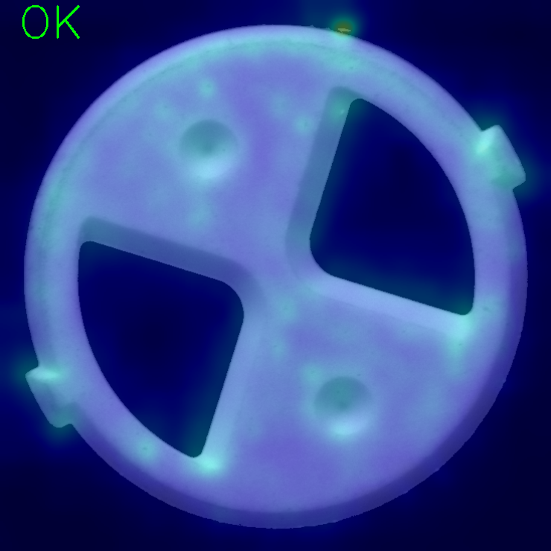
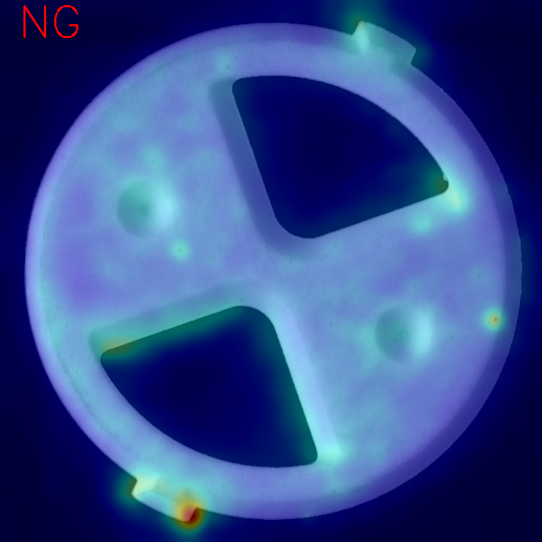
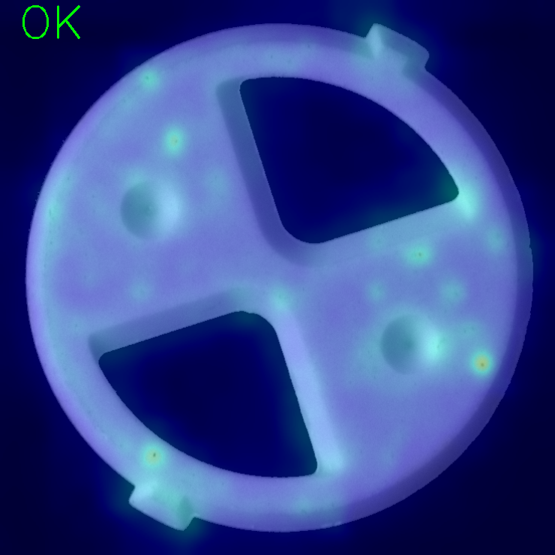
Problem and Solution (140N)

Slide 73
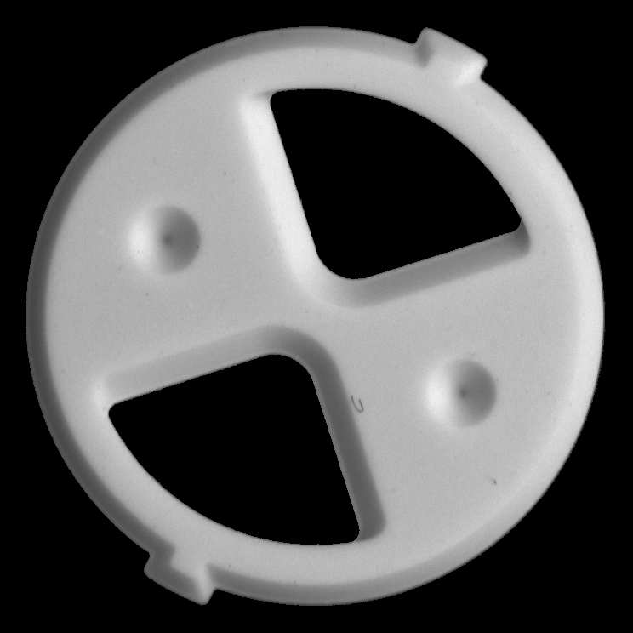
Problem and Solution (140N)
1. Find the slope between the center of the black triangle and the center of the water valve.
2. Get the angle of the slope through the Math.Atan function.
3. Rotate the photograph.

Slide 74
Problem and Solution (140N)
Before
After

Slide 75
Problem and Solution (140C)
Before
By Cv2.convexhull
After

Slide 76
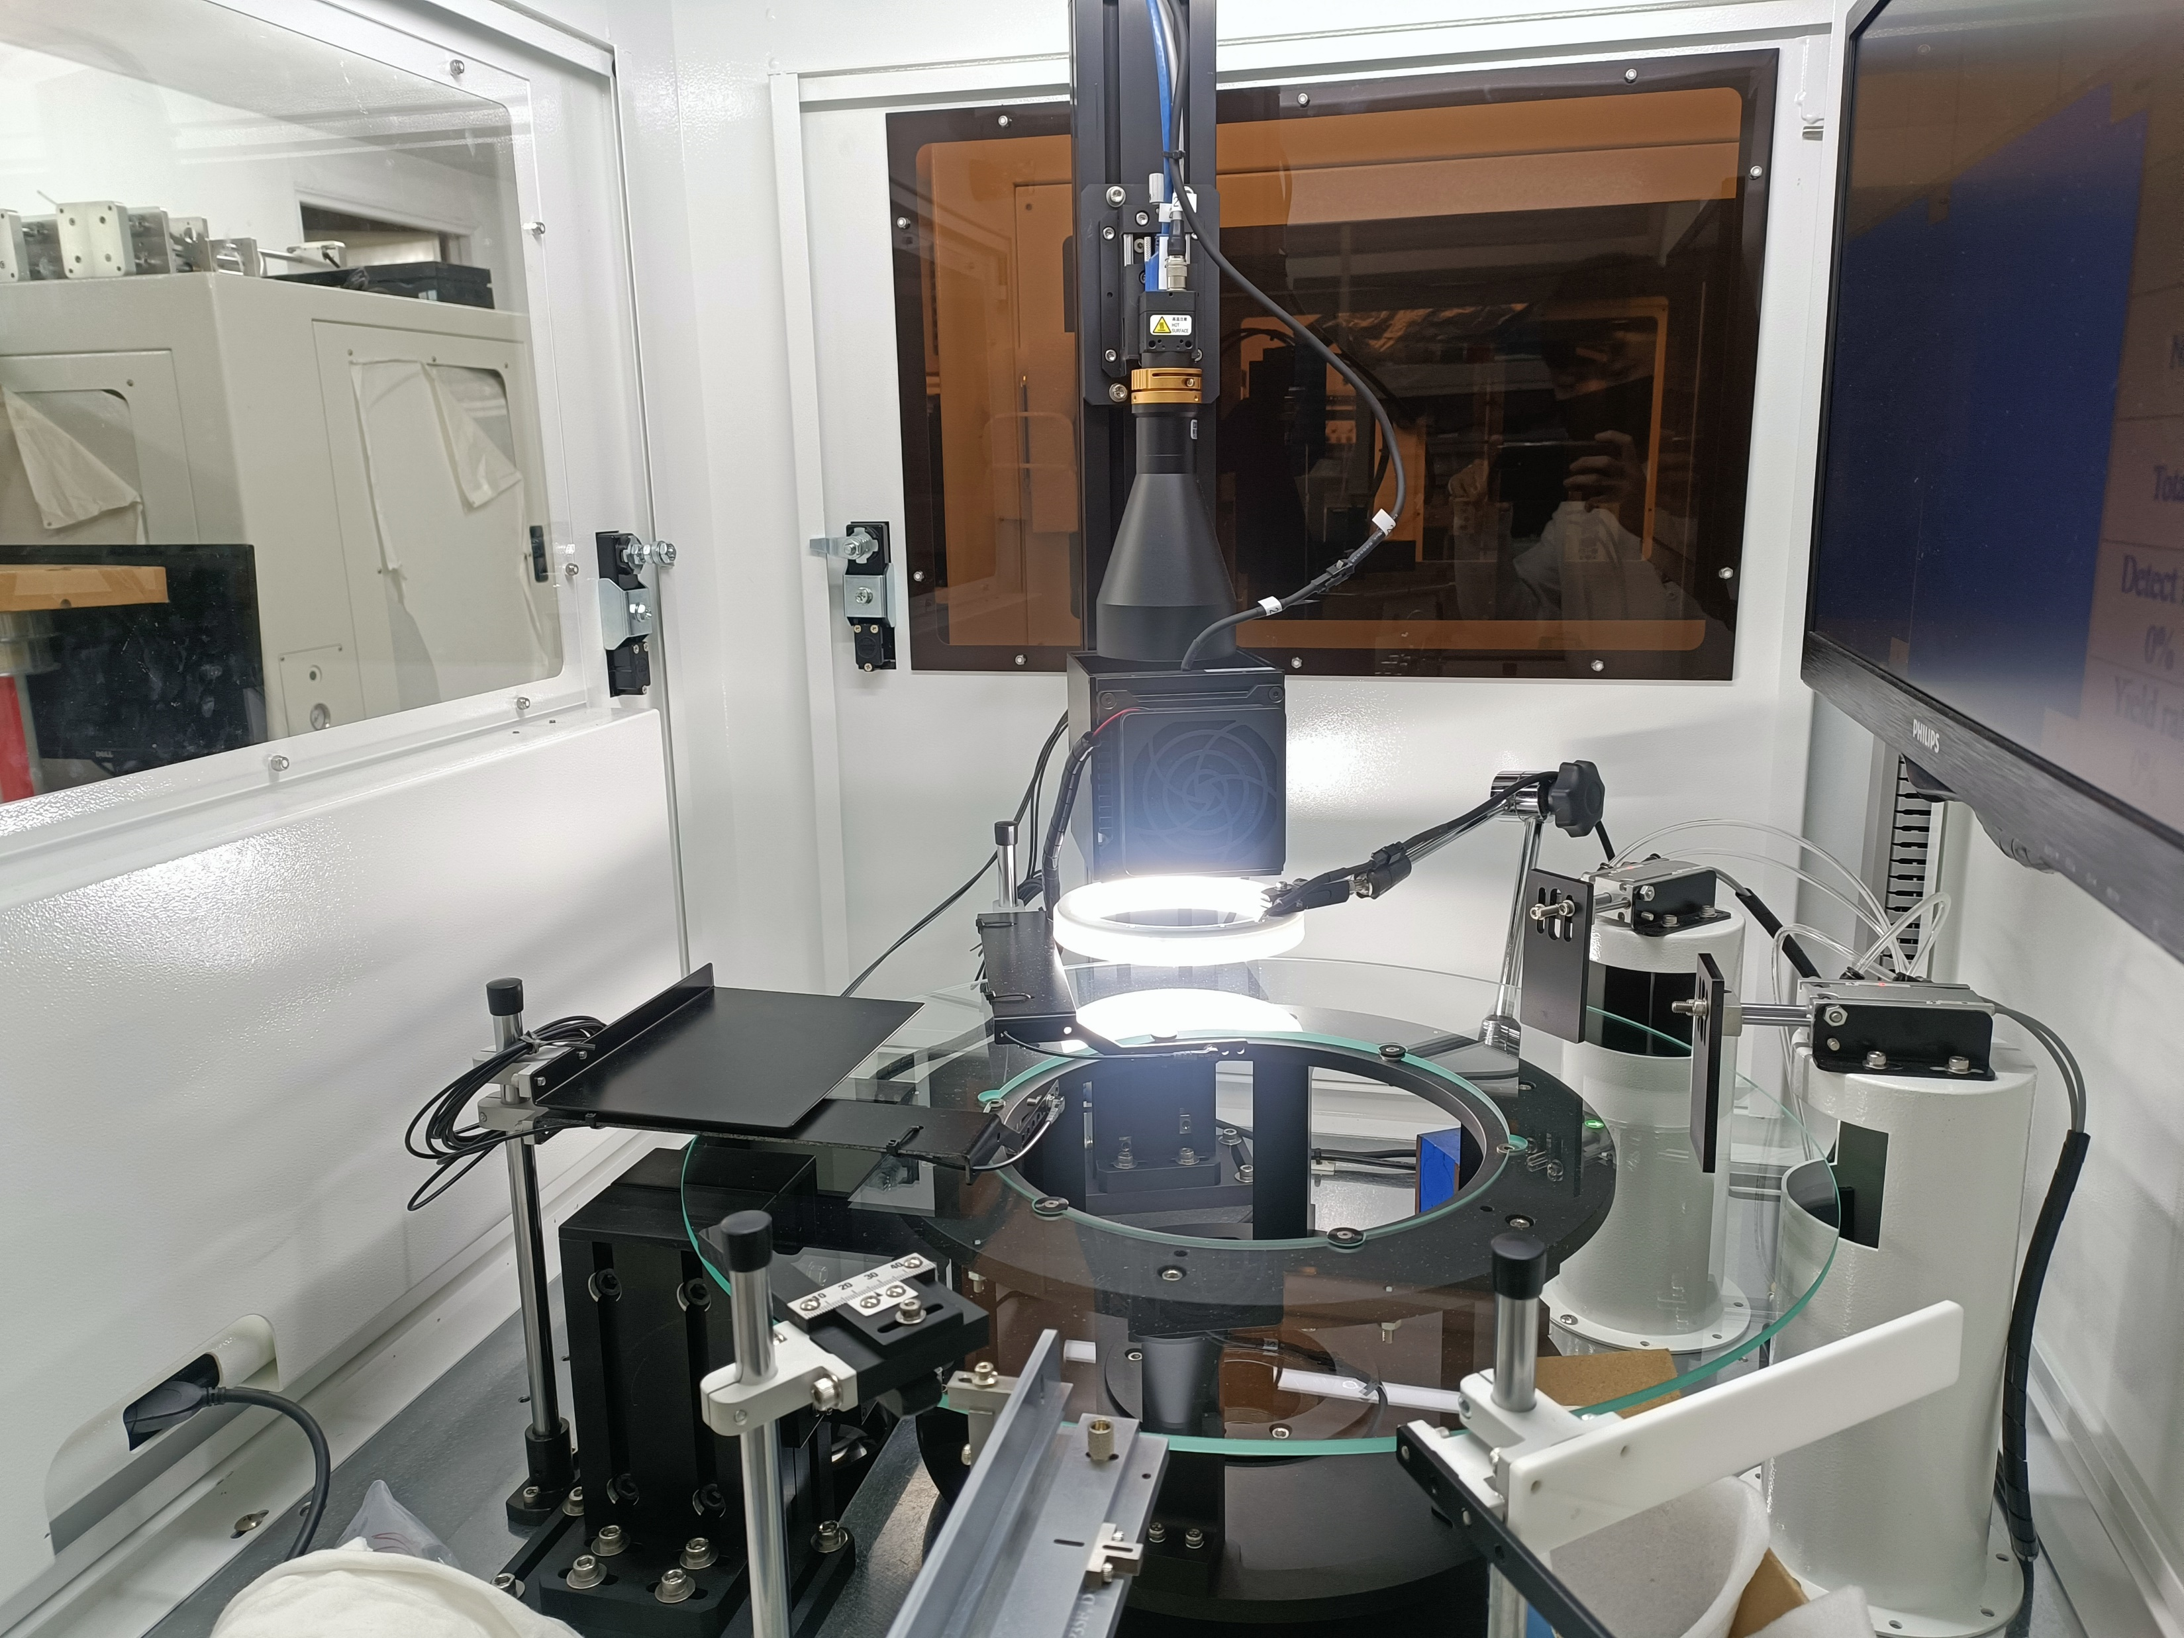
Problem and Solution (140C)
Chipping not clear
New light
Result

Slide 77
Problem and Solution (M38N)
Before
By Cv2.convexhull
After

Slide 78
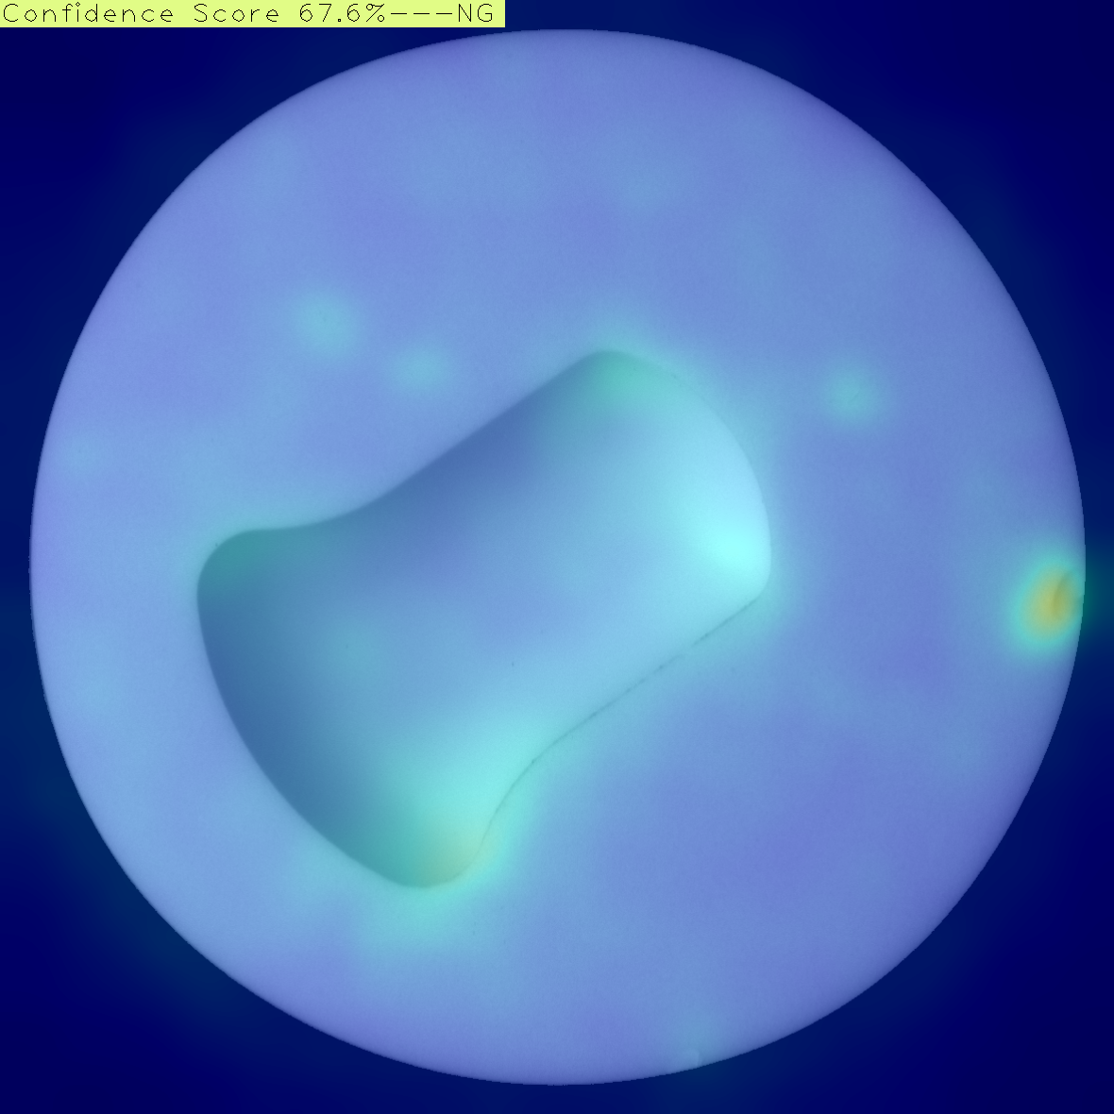
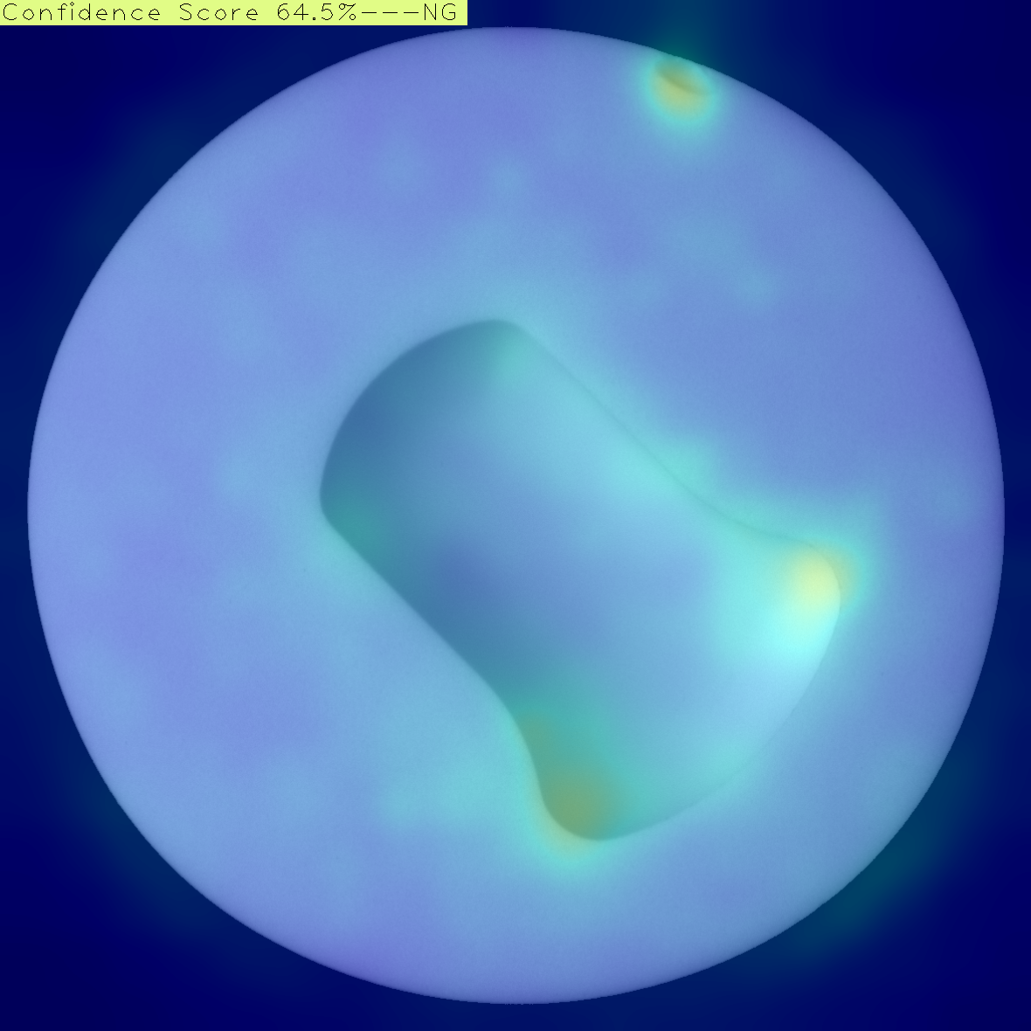
Problem and Solution (D69M)
Anomalib gets confused at the arc part

Slide 79
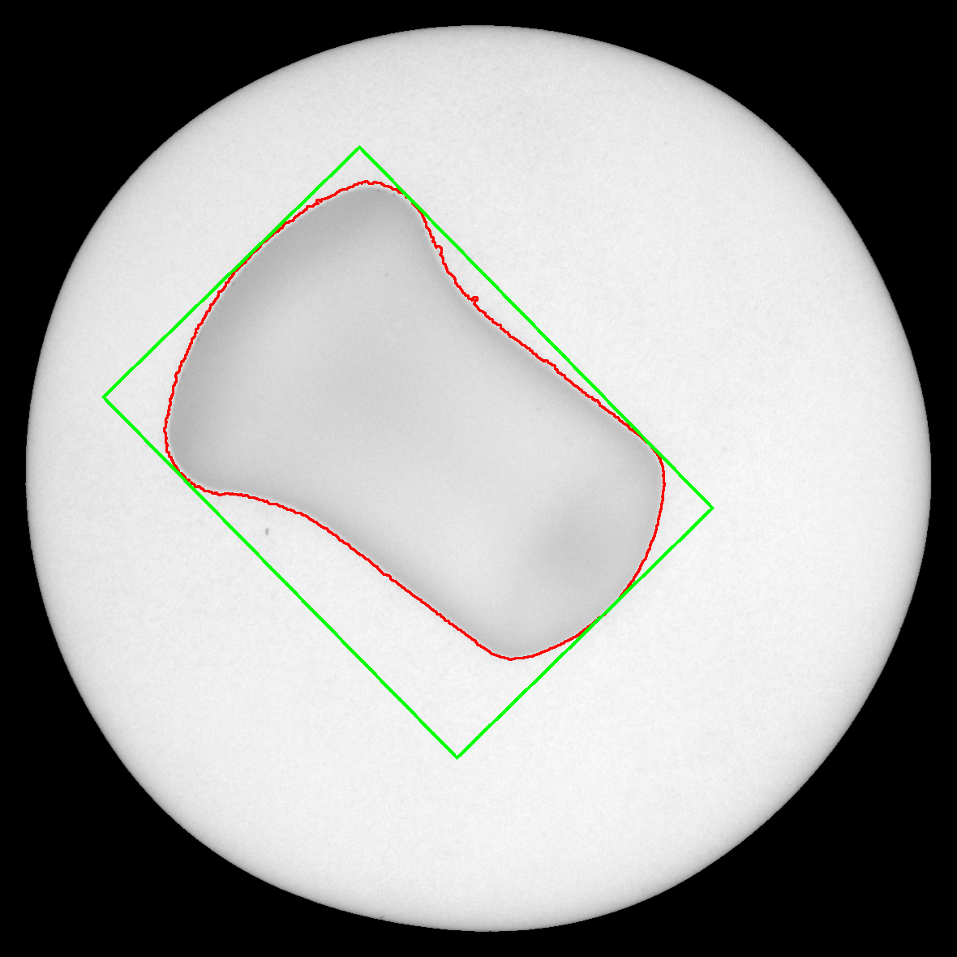
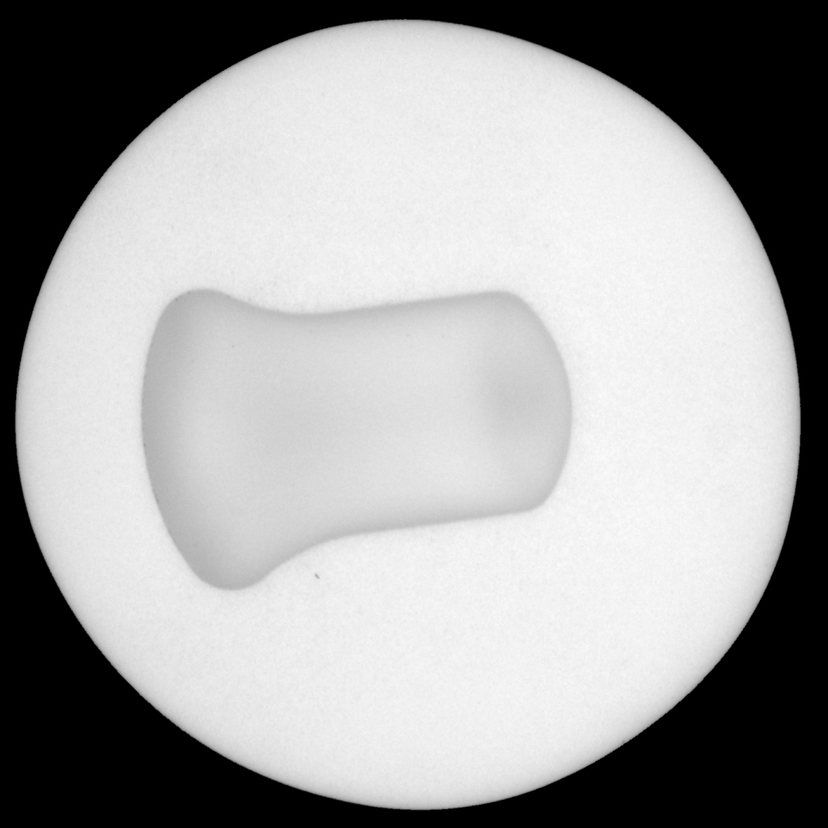
Problem and Solution (D69M)
1. Find the angle of center part by Cv2.MinAreaRect function.
2. Rotate the photograph.
Before
After

Slide 80
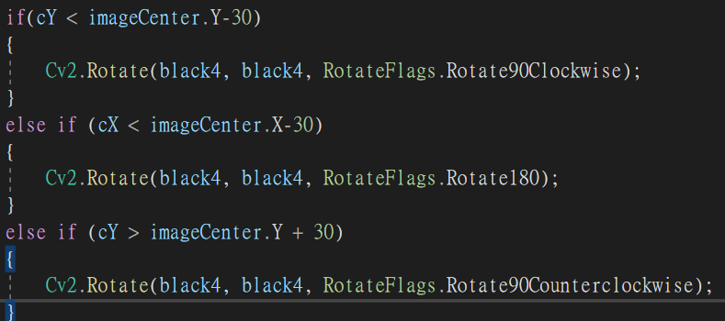
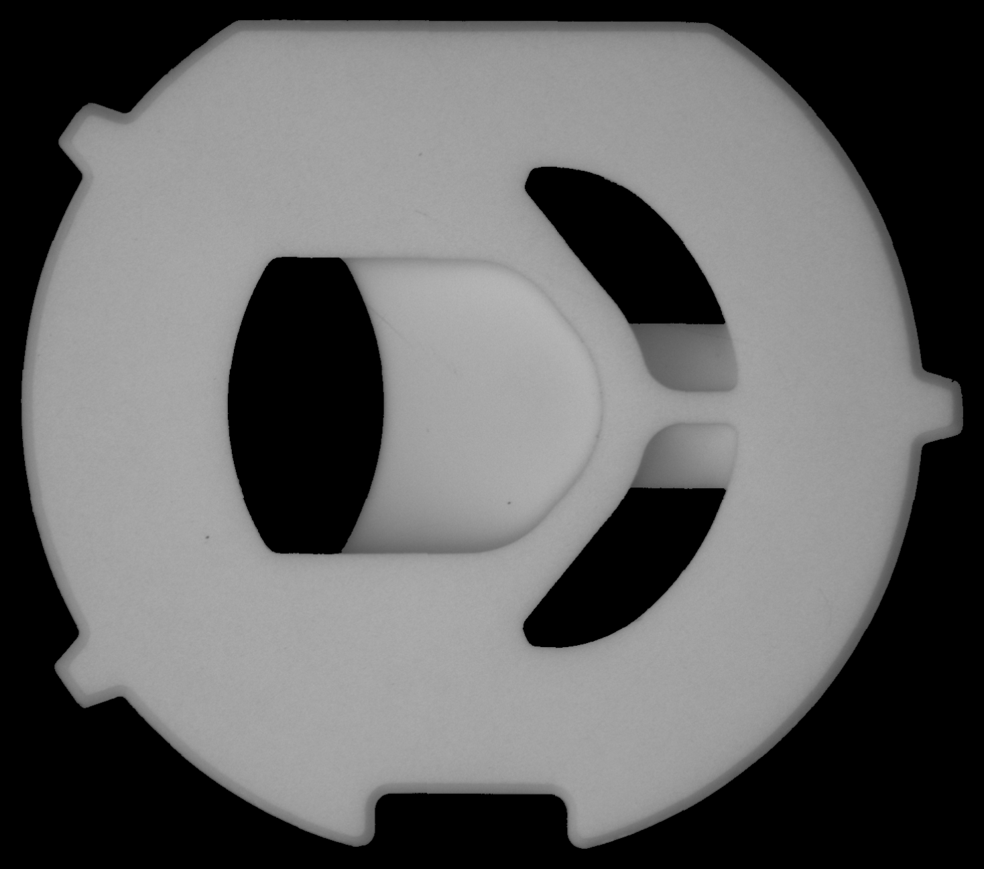
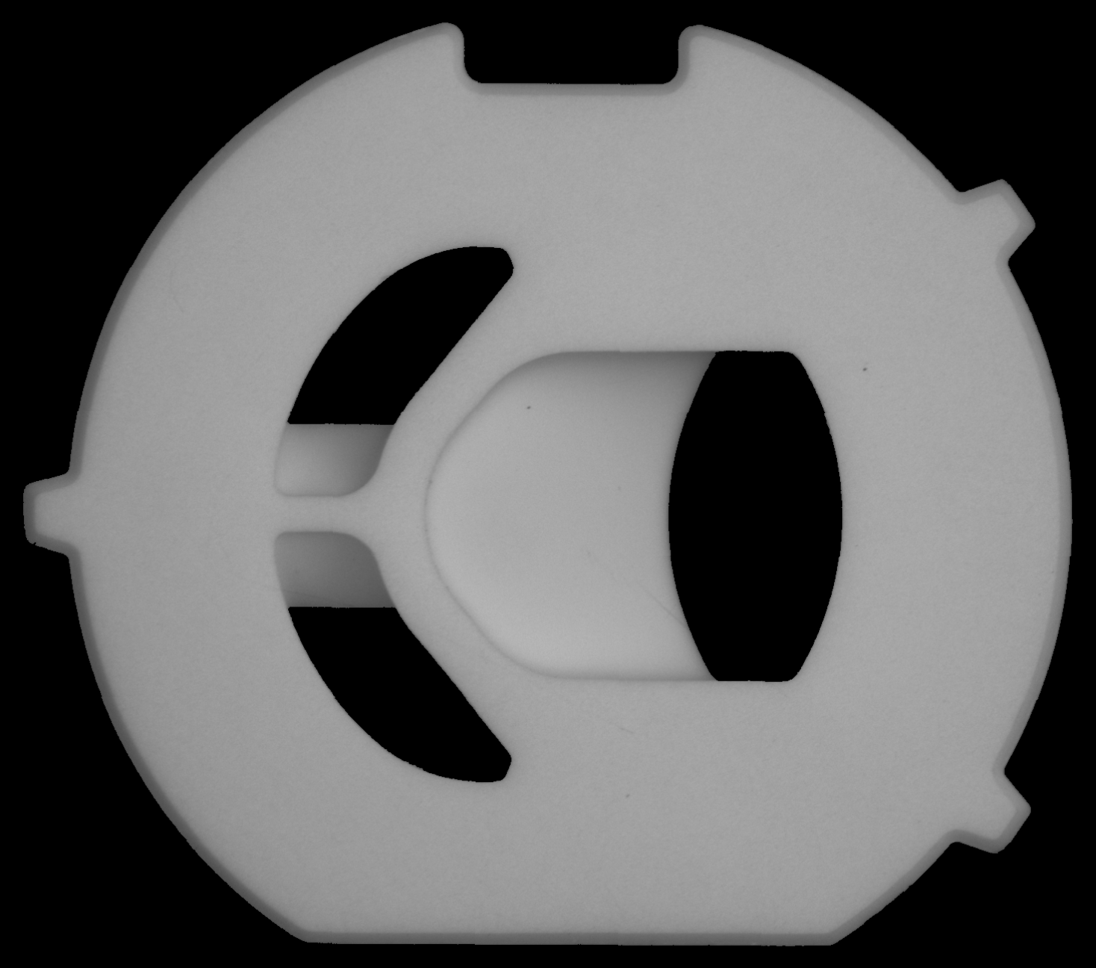
Problem and Solution (M89F)
1. Find the center of the mouth part.
2. If the center is not on the right side, rotate it.
Before
After

Slide 81
Problem and Solution Why YOLO and Anomalib?
Spot will affect the result of Anomalib.
Hence, we decided to use YOLO to find the spot and cracks.
Also, we used Anomalib to find the chipping.

Slide 82
Anomalib Finds Chipping; YOLO Finds Spot
0.0204mm/ pixel

Slide 83
GUI Function
(a)
(a)
(f)
(e)
(b)
(b)
(c)
(g)
(c)
(h)
(i)
(j)
(k)
(d)
(d)
(l)

Slide 84
GUI
Save image
Report

Slide 85
Inspect Speed
140N/ 0.3sec
140C/ 0.3sec
KNT1/ 0.3sec
KNT2/ 0.5sec
YNT2/ 0.5sec
D68F/ 0.4sec
D69M/ 0.4sec
M38N/ 0.4sec
M89F/ 0.6sec
P35F/ 0.4sec
P35M/ 0.4sec.

Slide 86
Results
Only Front | Good | OK | NG | Yield Rate | Spot | OK | NG | Yield Rate | Chipping | OK | NG | Yield Rate | Chipping_Crack | OK | NG | Yield Rate | Crack | OK | NG | Yield Rate | No_Lapping | OK | NG | Yield Rate
140N |  | 75 | 12 | 86.21% |  | 29 | 19 | 60.42%
140C |  | 38 | 6 | 86.36% |  | 31 | 18 | 63.27% |  | 2 | 12 | 14.29% |  |  |  |  |  |  |  |  |  | 2 | 11 | 15.38%
KNT1 |  | 38 | 12 | 74.51% |  | 12 | 38 | 23.53% |  |  |  |  |  |  |  |  |  |  |  |  |  | 0 | 15 | 0%
KNT2 |  | 75 | 10 | 88.24% |  | 37 | 18 | 66.07%
YNT2 |  | 74 | 8 | 90.24% |  | 45 | 6 | 86.54% |  | 4 | 11 | 26.27%
D68F |  | 78 | 20 | 79.59% |  | 3 | 11 | 21.43% |  | 7 | 7 | 50% |  | 2 | 12 | 14.29%
D69M |  | 52 | 44 | 53.61% |  | 3 | 11 | 21.43% |  | 4 | 11 | 26.67%
M38N |  | 71 | 22 | 76.34% |  | 6 | 8 | 42.86% |  | 4 | 11 | 26.67%
M89F |  | 69 | 27 | 71.13% |  | 1 | 14 | 6.67% |  | 2 | 12 | 14.29% |  |  |  |  |  | 0 | 15 | 0% |  | 0 | 14 | 0%
P35M |  | 25 | 10 | 71.43% |  | 2 | 49 | 3.85% |  | 3 | 12 | 20%
P35F |  | 85 | 14 | 85% |  |  |  |  |  | 7 | 8 | 47% |  |  |  |  |  | 1 | 47 | 2.08%
Two sides | Good | OK | NG | Yield Rate | Spot | OK | NG | Yield Rate | Chipping | OK | NG | Yield Rate | Chipping_Crack | OK | NG | Yield Rate | Crack | OK | NG | Yield Rate | No_Lapping | OK | NG | Yield Rate
140N |  | 71 | 17 | 80.68% |  | 25 | 24 | 51.02%
140C |  | 39 | 5 | 84.78% |  | 31 | 19 | 62% |  | 1 | 13 | 7.14% |  |  |  |  |  |  |  |  |  | 2 | 11 | 15.38%
KNT1 |  | 36 | 14 | 72% |  | 9 | 42 | 17.65% |  |  |  |  |  |  |  |  |  |  |  |  |  | 0 | 15 | 0%
KNT2 |  | 69 | 16 | 81.18% |  | 30 | 26 | 53.57%
YNT2 |  | 69 | 12 | 84.51% |  | 44 | 8 | 84.61% |  | 5 | 10 | 33.33%
D68F |  | 49 | 49 | 50% |  | 1 | 13 | 7.14% |  | 2 | 12 | 13.33% |  | 1 | 13 | 7.14%
D69M |  | 49 | 48 | 50% |  | 2 | 12 | 14.29% |  | 2 | 13 | 13.33%
M38N |  | 53 | 40 | 56.38% |  | 0 | 14 | 0% |  | 5 | 10 | 33.33%
M89F |  | 49 | 48 | 50% |  | 0 | 15 | 0% |  | 3 | 11 | 21.43% |  |  |  |  |  | 0 | 15 | 0% |  | 0 | 14 | 0%
P35M |  | 19 | 16 | 54% |  | 0 | 51 | 0% |  | 0 | 15 | 0%
P35F |  | 86 | 12 | 86.87% |  |  |  |  |  | 6 | 9 | 40% |  |  |  |  |  | 0 | 48 | 0%

Slide 87
Problem
Spot on the side
Chipping from front view
Chipping from side view

Slide 88
Conclusion
Method: Anomalib and YOLOv5
Steps: Put Valve Core on Vibrating Plate => User Sets GUI => AI Decides if Reverse => First Side Decides if OK => Second Side Decides if OK => PLC Control => Push Them on Right Site
Results: We could inspect 11 types of water valve core defects through one machine.

Slide 89
References
Water valve pictures https://zhuanlan.zhihu.com/p/213960356
Gaussian Blur pictures https://blog.csdn.net/chentravelling/article/details/48985561
Erode Dilate pictures https://theailearner.com/category/image-processing/page/5/
Histogram normalization pictures https://blog.csdn.net/Vermont_/article/details/108360007
Convex hull pictures https://www.cnblogs.com/jclian91/p/9728488.html
Anomalib https://github.com/openvinotoolkit/anomalib https://arxiv.org/pdf/2202.08341v1.pdf
PaDiM https://arxiv.org/pdf/2011.08785.pdf
HSV https://zh.wikipedia.org/wiki/HSL%E5%92%8CHSV%E8%89%B2%E5%BD%A9%E7%A9%BA%E9%97%B4
Resnet https://arxiv.org/pdf/1512.03385v1.pdf https://blog.csdn.net/weixin_36979214/article/details/108879684?ops_request_misc=%257B%2522request%255Fid%2522%253A%2522162374909216780265420718%2522%252C%2522scm%2522%253A%252220140713.130102334..%2522%257D&request_id=162374909216780265420718&biz_id=0&utm_medium=distribute.pc_search_result.none-task-blog-2~all~sobaiduend~default-1-108879684.first_rank_v2_pc_rank_v29&utm_term=pytorch+resnet18&spm=1018.2226.3001.4187
YOLO https://arxiv.org/pdf/1506.02640.pdf https://github.com/ultralytics/yolov5

Slide 90
References
S. Akcay, D. Ameln, A. Vaidya, B. Lakshmanan, N. Ahuja, and U. Genc, “Anomalib: A Deep Learning Library for Anomaly Detection,” Proceedings of IEEE International Conference on Image Processing, Bordeaux, France, pp. 1706 - 1710, 2022.
Z. Chen, X. Huang, "End-to-End Learning for Lane Keeping of Self-Driving Cars," Proceedings of IEEE Intelligent Vehicles Symposium, vol. 4, pp. 1856-1860, 2017.
T. Defard, A. Setkov, A. Loesch, and R. Audigier, "PaDiM: a Patch Distribution Modeling Framework for Anomaly Detection and Localization," Proceedings of International Conference on Pattern Recognition, International Workshops and Challenges, Virtual, vol. 12664, pp. 475-489, 2021.
A. Dogra and A. Dogra, "Performance Comparison of Gaussian and Elliptic High Pass Filter," Proceedings of International Journal of Advanced Biological and Biomedical Research, vol. 3, no. 1, pp. 93-96, 2014.
D. Eberly, "Minimum-Area Rectangle Containing a Set of Points," https://www.geometrictools.com/Documentation/MinimumAreaRectangle.pdf, 2023.
K. Erickson, "Programmable Logic Controllers," Proceedings of IEEE Potentials, vol. 15, no. 1, pp. 14 - 17, 1996.
R. Girshick, J. Donahue, T. Darrell, and J. Malik, "Region-Based Convolutional Networks for Accurate Object Detection and Segmentation," Proceedings of IEEE Transactions on Pattern Analysis and Machine Intelligence, vol. 38, no. 1, pp. 142-158, 2016.
D. Gudovskiy, S. Ishizaka, and K. Kozuka, "CFLOW-AD: Real-Time Unsupervised Anomaly Detection with Localization via Conditional Normalizing Flows," Proceedings of IEEE/CVF Winter Conference on Applications of Computer Vision, Waikoloa, HI, pp. 1819 - 1828, 2022.
K. He, X. Zhang, S. Ren, and Jian Sun, "Deep Residual Learning for Image Recognition," Proceedings of IEEE Conference on Computer Vision and Pattern Recognition, Las Vegas, NV, pp. 770-778, 2016.
G. Jocher, "YOLOv5," https://github.com/ultralytics/yolov5, 2023.

Slide 91
References
Y. Lecun, L. Bottou, Y. Bengio, and P. Haffner, "Gradient-Based Learning Applied to Document Recognition," Proceedings of the IEEE, vol. 86, no. 11, pp. 2278 - 2324, 1998.
B. Leibe, A. Leonardis, and B. Schiele , "Robust Object Detection with Interleaved Categorization and Segmentation," Proceedings of International Journal of Computer Vision, vol. 77, no. 1, pp. 259-289, 2008.
Y. Q. Liu, X. Du, H. L. Shen, and S. J. Chen, "Estimating Generalized Gaussian Blur Kernels for Out-of-Focus Image Deblurring," Proceedings of IEEE Transactions on Circuits and Systems for Video Technology, vol. 31, no. 3, pp. 829-843, 2021.
L. G. Nyul, J. K. Udupa, and X. Zhang, "New Variants of a Method of MRI Scale Standardization," Proceedings of IEEE Transactions on Medical Imaging, vol. 19, no. 2, pp. 143-150, 2000.
J. Redmon, S. Divvala, R. Girshick, and A. Farhadi, "You Only Look Once: Unified, Real-Time Object Detection," Proceedings of IEEE Conference on Computer Vision and Pattern Recognition, Las Vegas, NV, pp. 779-788, 2016.
K. Roth, L. Pemula, J. Zepeda, B. Schölkopf, T. Brox, and P. Gehler, "Towards Total Recall in Industrial Anomaly Detection," Proceedings of IEEE/CVF Conference on Computer Vision and Pattern Recognition, New Orleans, LA, pp. 14298 - 14308, 2022.
O. Russakovsky, J. Deng, H. Su, J. Krause, S. Satheesh, S. Ma, Z. Huang, A. Karpathy, A. Khosla, M. Bernstein, A. C. Berg, and F. F. Li, "ImageNet Large Scale Visual Recognition Challenge," Proceedings of International Journal of Computer Vision, vol. 115, p. 211–252, 2015.
P. K. Sahoo, S. Soltani, and A. K. C. Wong, "A Survey of Thresholding Techniques," Proceedings of Computer Vision, Graphics, and Image Processing, vol. 41, no. 2, pp. 233-260, 1988.
K. A. M. Said and A. B. Jambek, "Analysis of Image Processing Using Morphological Erosion and Dilation," Proceedings of Journal of Physics: Conference Series, vol. 2071, no. 1, pp. 1-6, 2021.
M. Sharif, "A New Approach to Compute Convex Hull," Proceedings of Innovative Systems Design and Engineering, ISSN (Online) 2222-2871, vol. 2, no. 3, pp. 1-8, 2011.

Slide 92
References
D. Silver, A. Huang, C. J. Maddison, A. Guez, L. Sifre, G. V. D. Driessche. J. Schrittwieser, I. Antonoglou, V. Panneershelvam, M. Lanctot, S. Dieleman, D. Grewe, J. Nham, N. Kalchbrenner, I. Sutskever, T. Lillicrap, M. Leach, K. Kavukcuoglu, T. Graepel, and D. Hassabis, "Mastering the Game of Go with Deep Neural Networks and Tree Search," Proceedings of Nature, vol. 529, pp. 484-503, 2016.
A. R. Smith, "Color Gamut Transform Pairs," Proceedings of ACM SIGGRAPH Computer Graphics, vol. 12, no. 3, pp. 12-19, 1978.
A. M. Turing, "Computing Machinery and Intelligence," Proceedings of Mind, vol. 59, no. 236, pp. 433-460, 1950.
X. Yu, T. W. Kuan, Y. Zhang, and T. Yan, "YOLO v5 for SDSB Distant Tiny Object Detection," Proceedings of International Conference on Orange Technology, Shanghai, China, vol. 10, pp. 1-4, 2022.
K. P. Zhang, Z. P. Zhang, Z. F. Li, and Y. Qiao, "Joint Face Detection and Alignment Using Multitask Cascaded Convolutional Networks," Proceedings of IEEE Signal Processing Letters, vol. 23, no. 10, pp. 1499-1503, 2016.

